Slide 1
Mars Rover CDR
York Area Rocketry Team

Slide 2
Presentation Overview
System Overview
Mission Summary
System Requirements
System Level Concept Trade
System Concept of Operations
Physical Layout
Overview of Rocket
Major Components Identified
Rocket Weight
Motor Selection
Airframe Diameter
Fin Size
Number of Fins
Length of Rocket
CP and CG Identified

Slide 3
Presentation Overview(Cont.)
Overview of Rocket (Cont.)
Rocket Materials
Rocket Recovery System
Parachute Selection
Decent Rate
Type of Shock Cord
Linkages and Strengths
Attachment Points to Frame
Parachute of Selection
Parachute Protection
Parachute Ejection
Altimeter/Motor Ejection
Rocket Motor Selection
Primary Motor Selection

Slide 4
Presentation Overview(Cont.)
Rocket Motor Selection (Cont.)
Primary Motor Thrust to Weight Ratio
Secondary Motor
Secondary Motor Thrust to Weight Ratio
Primary Motor Flight Simulation
Secondary Motor Flight Simulation
Rover Design
Rover Design Overview, Rover Mechanics, Rover Materials, Rover Descent Control, Rover Mass
Rover Electronics, Rover Camera, Rover Image Transmission
Rover Image Transmission
Rover Power, Rover Power Distribution
Rover Markers
Rover Software Design, Software Flowchart, Rover Payload Integration

Slide 5
Presentation Overview(Cont.)
Rover Testing
Subsystem testing
Intergration Testing
Functional Testing
Rocket Testing
Parachute Deployment Testing
Payload Deployment Testing
Flight Testing
Flight Operations
Rocket Prep
Rover Prep
Rover Intergration into Rocket
Launch Pad Preparation
Rover aiming process

Slide 6
Presentation Overview(Cont.)
Program Schedule
Gantt Chart
Component and Service Schedule
Program Budget
Rover Component
Rocket Components
Services
Travel expenses
Summary

Slide 7
Presentation Outline
Team Member Name | Section Presenting
Adam Winchell | Intro & Rocket Design
Zach Ruth | Rocket Design
Sarah Staley | System Overview
Ryan Shields | System Overview
Gabe Berman | Schedule
Jakub Becker | Rover Design
Michael Geyer | Rover Design
Tyler Sengia | Testing & Schedule
Hayden Forbush | Budgeting

Slide 8
Team Organization
Team Member Name & Grade | Team Member Role
Adam Winchell – 12 | Team Captain
Zachary Ruth – 12 | Team Co-Captain
Tyler Sengia -12 | Rover Software Developer
Michael Geyer -12 | Rover Hardware Developer
Ryan Shields -12 | System Developer
Jakub Becker – 11 | Rover Manufacturing
Sarah Staley – 11 | Electronics Bay Developer
Gabriel Berman -11 | Team Safety Officer
Hayden Forbush -9 | Financial Scheduler
Team Member Name | Section Presenting
Adam Winchell | Intro & Rocket Design
Zach Ruth | Rocket Design
Sarah Staley | System Overview
Ryan Shields | System Overview
Gabe Berman | Schedule
Jakub Becker | Rover Design
Michael Geyer | Rover Design
Tyler Sengia | Testing & Schedule
Hayden Forbush | Budgeting

Slide 9
Acronyms
PDR: Preliminary design review
CDR: Critical design review
CONOPS: Concept of operations
CP: Center of pressure
CG: Center of Gravity
MDRA- Maryland-Delaware Rocketry Association
TWR – Thrust to Weight Ratio
UTS – Ultrasonic Sensor
ICST – Image Capture Storage and Transmission
TANK – Treaded Automated Navigational Kit

Slide 10
System Overview

Slide 11
Mission Summary
Design a rocket and Mars rover to launch to at least 1000 feet and deploy the Mars rover. The Mars rover must be fully contained in the rocket before being deployed. Once deployed, the Mars rover must return to the ground safely. When it lands, the rover will take a picture with a camera. Up to four images will be taken, each image in the forward, left, right, and rear direction. Afterwards, the Mars rover shall release a bright colored marker that can be easily found. The marker must be placed at the point of landing. It cannot be tossed, shot, or projected beyond its landing location. Once released, the rover must then travel 10 feet and release a second marker. The rover then must turn or move 90 degrees in either direction and travel 10 feet. Travel must be completed within ten minutes. Time starts at the time of landing. Method of travel is up to the team.

Slide 12
System Requirement Summary Rover
Rover must weigh less than 2 Kg completely within the rocket while working autonomously
Rover recovery system must be secure and no pyrotechnics are allowed
4 pictures will be taken in color at 640x480 or higher
At landing, the rover must release the recovery system
Must travel 10 feet or 120 inches then drop a marker
Travel a minimum of two feet in each segment
The rover must be able to detect when it has flown and landed
Travel must be completed within 10 minutes of landing

Slide 13
System Requirement Summary Rocket
Total installed impulse shall not exceed 2,560 Newton-seconds or a K motor
All parts of the rocket must safely return under a recovery system
The airframe, nose cone, fins, bulk plates, and centering rings cannot be made of any types of metal
The rocket must reach at least 1000 feet
Must use a commercial altimeter
Average TWR must be greater than 5:1
The rocket must use a motor retainer

Slide 14
System Concept of Operations Rover
Provide overview of operations of the system from launch to landing to rover operations.
Launch and descent operations
Rover Operations
Ultrasonic Sensor detects when to release parachute from lander
Lander makes contact, arms extend, and lander is righted if landed on side
Cameras takes pictures and write them to SD cards
Tank protocol begins, and tank drives out of lander
Pictures are relayed to ground station
Tank stops at 10 ft, moves turret to release marker, turns and continues
Post-launch recovery
Simple flow diagrams and cartoons are a good way to present the CONOPS

Slide 15
System Level Concept
“Rover”
Lander
“Tank”
Structure
Parachute Subsystem
Structure
Electronics
Deployment Subsystem
Electronics
Marker
Deployment
Communication
Notes:
Present final system level concept of the rocket and rover.
This is an overview of what will be shown later in greater detail
Identify major parts

Slide 16
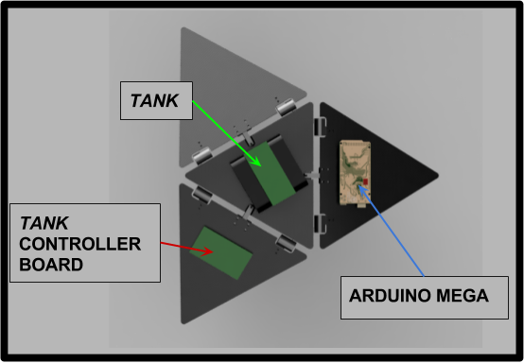
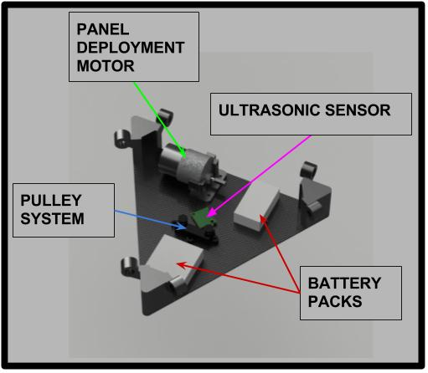
Physical Layout

Slide 17
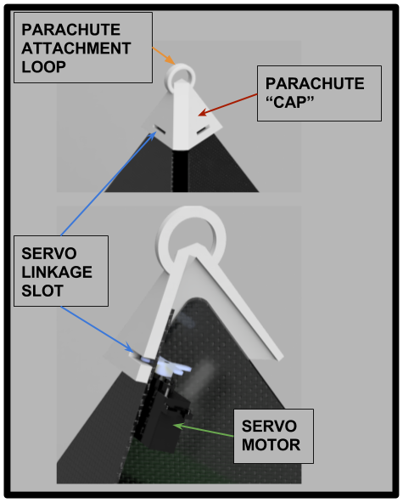
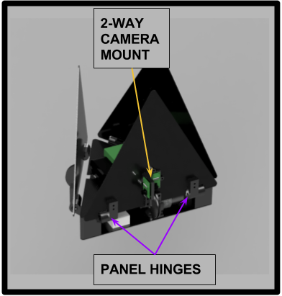
Physical Layout cont.

Slide 18
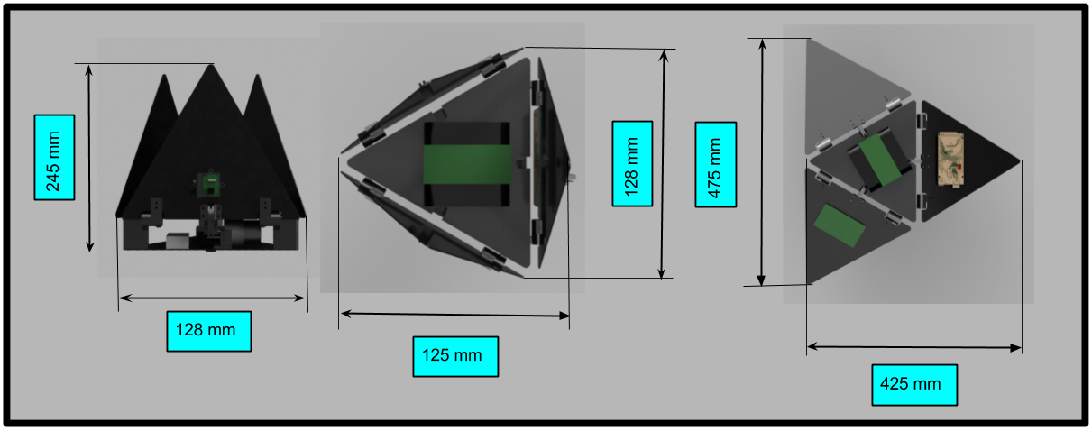
Physical Layout cont.

Slide 19
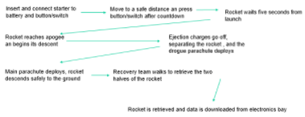
System Concept of Operations Rocket
Overview of operations of the system from launch to landing to Payload operations.

Slide 20
Post Launch Recovery
Safety officer and team adviser will go out to retrieve the rocket.
They will use the tracking receivers in order to locate the rocket sections.
The electronics will be disarmed using the “Remove Before Flight” keys, and the black powder charges will be checked by the team advisor for any possible dangers.
The rocket will then be deemed safe to carry, and transport back to base of operations.

Slide 21
Physical Layout of Rocket
Diagram of rocket showing major components
The rocket will be 141 inches long, and have a 12 inch diameter body tube.
The rover will be located in the front half of the body tube, along with the main parachute while the drogue chute will be in the back half of the body tube.
The E-Bay will be setting off an ejection charge. This charge will blow off the nosecone, causing it to pull the rover in the sabot out of the front boy tube.
Front body tube
Fins
Nose cone
Back body tube
Rover
E-Bay

Slide 22
Physical Layout of Rover
Diagram of rover
H: 355mm W: 280mm L: 280mm
Major Components
tank - Free from lander, flying during maneuvers
tank Controller - Housed in lander, controlled by Arduino
Arduino - Housed in Lander, main interface for components
Ultrasonic Sensor - Housed in cutout in bottom of lander, senses ground approaching to signal release of parachute
Camera - Housed on top of lander
Base station - Kept at launch site, used to recover pictures wirelessly

Slide 23
Rocket Design

Slide 24
Changes Since PDR - Rocket
The material used for the body tubes has been changed to phenolic tubing to decrease mass of the rocket and to obtain a TWR of at least 5:1
Fin design has been changed to move Center of Pressure back, increasing stability and reducing the mass as well.
The new motor selected is a Cesaroni K1440 White Thunder. This motor will get our redesigned rocket to the target altitude, and it meets the 5:1 TWR requirement

Slide 25
Changes Since PDR - Rover

Slide 26
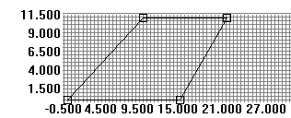
Overview of Rocket
Describe overall rocket design
Nose cone connected to front body tube, which is connected to the electronics bay, serving as a tube coupler between the front and back body tubes. Fins are attached to the back body tube, and the motor tube is inserted and mounted inside the back body tube
Total Weight – 52.70 lbs.
Motor - Cesaroni K1440
Diameter – 12”
The rocket is built with
a three-fin-design.
141.13 inches (11 ft. 9 in.)
CG is 79.94 inches from the front end and CP is 101.14 inches. This is 21.2 inches apart, and based on the diameter of the rocket, this gives a margin of 1.86.

Slide 27
Rocket Materials
Airframe Material - 1/8 inch Phenolic Tubing
Fin Material - 1/8 inch fiberglass fins
Nosecone material – Fiberglass
Adhesives Used - Rocket-Poxy, 5-Minute Epoxy, and JB Weld. They were all used for centering ring and fin attachment
Rail Guides - Unistrut Rail Buttons
Active Motor Retention using Aeropack Motor Retainer

Slide 28
Rocket Recovery System
Parachute selection- 10 ft Iris Ultra parachute from Fruity Chutes for main parachute, and 72 inch elliptical for drogue parachute
Descent Rate Under main- 17.26 ft/s
Descent Rate Under drogue- 26.16 ft/s
Harnesses
7/16 inch tubular Kevlar, 25 feet long for front, and 25 feet for back half
Swivel to hold parachute using quick links. 880 lbs. max
Quick links attached to parachutes are attached to the swivel on the shock cord which are secured to U-Bolts on the rocket using quick links
Parachutes are protected by Nomex heat shields, and Nomex sleeves are put on the shock cord for protection

Slide 29
Rocket Recovery System Deployment Method
Altimeter used will be a PerfectFlite Stratologger CF. Ejection charges will be at apogee and 600 feet above the ground. It will be Altimeter-Based Ejections (Primary and Secondary)
When loading, an 18 year old student holds electronics bay, while the NAR mentor loads and seals the black powder ejection wells.
To arm the recovery system, while on the pad, key switches are turned arming the altimeter. Key switches are removed and stored with the recovery team.
Key switches are turned arming the recovery system before the igniter is inserted to ensure safety in the case of an accidental launch.
Through online calculation and experience, we will be using 9.6 g of 4F grain size black powder for the front and back half to obtain an ejection pressure of 14 psi. We will testing extensively in ground ejection tests in order to get an exact desired and safe number.

Slide 30
Wiring diagram of altimeter
To Key Switches
To Drogue
To Drogue
To Main
Altimeter
Altimeter
To Main
9V Battery
9V Battery

Slide 31
Wiring diagram of altimeter
Main Primary
Drogue Primary
Main Secondary
Altimeter
Altimeter
Drogue Secondary

Slide 32
Rocket Motor Selection
Primary motor selection – Aerotech K1440 (6.1 : 1 TWR)
Secondary motor selection – Ceseroni K2000 VMAX (8.5 : 1 TWR)
RockSim 9 was used for all simulations

Slide 33
Test Flights
Show results of any test flights
There have been no test flights yet, as our January launch was canceled due to weather. We plan to have a launch on February 17 and 18 and one also in March if needed.

Slide 34
Rover Design

Slide 35
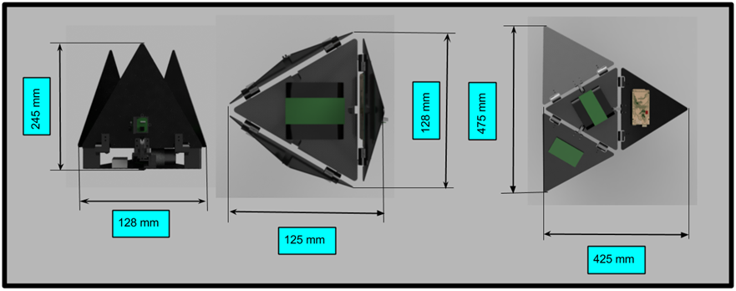
Rover Design Overview

Slide 36
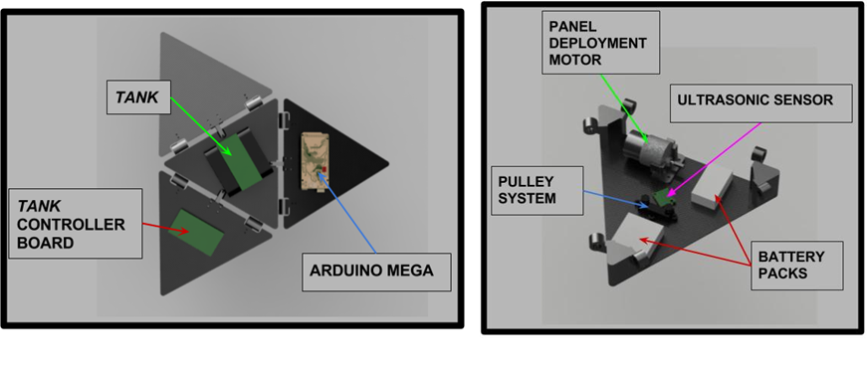
Rover Design Overview cont.

Slide 37
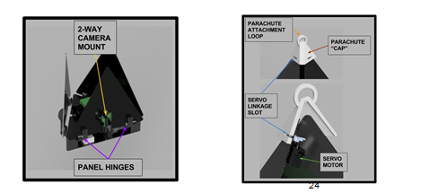
Rover Design Overview cont.

Slide 38
Mechanical Subsystem

Slide 39
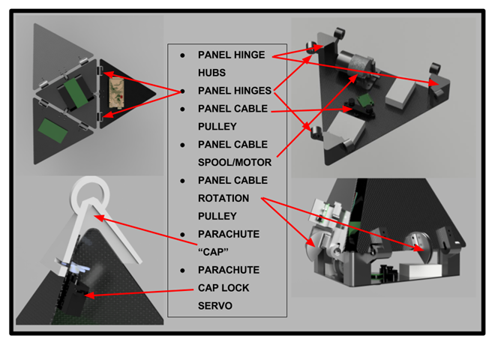
Mechanical Layout
Show Mechanical Layout of rover
Show structure of rover
Identify location of major components
Identify major mechanical parts

Slide 40
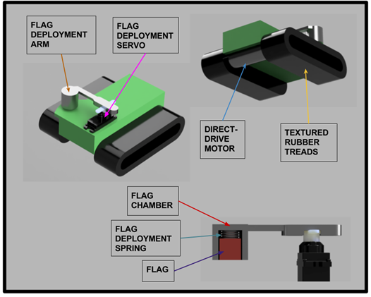
Mechanical Layout

Slide 41
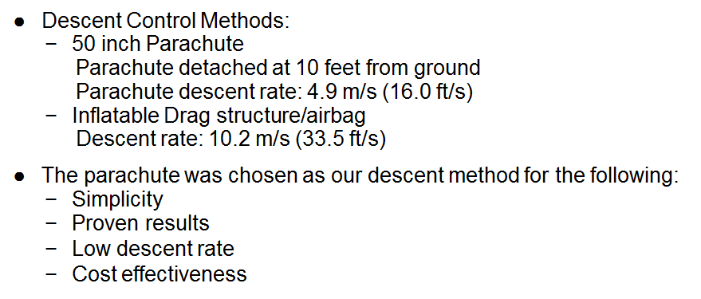
Rover Descent Control

Slide 42
Rover Mass Budget
Rover Mass Budget
Component | Mass (g) | total mass (g) | Uncertainty
Panels (x5) | 30.9 | 154.5 | 10
Motor | 138.5 | 138.5 | 0.1
3D printed components | 500 | 500 | 50
Electronics | 290 | 290 | 20
Power Systems | 105 | 105 | 10
TANK | 158 | 158 | 20
TOTALS: |  | 1346 | 110.1

Slide 43
Rover Electronics

Slide 44
Block Diagram
Parachute Separation
Tank Deployment/
Unfolding Mechanism
Power Source
Tank Controller
Ultrasonic Sensor
XBee
Alt. Power Source
Tank
Arduino
Accelerometer
SD Card Reader
Arming Button

Slide 45
Rover Electronics

Slide 46
Processor and Memory
●Arduino Mega
−ATmega2560, 256 kB flash, 8 kB SRAM, 4 kB EEPROM
−Operating Voltage: 5V, Input Voltage: 9V
−Processor Speed: 16 MHz
−54 digital IO pins, 16 analog input pins

Slide 47
Rover Sensors
●Identify sensors to be used to determine state of rover
−Ultrasonic Sensor (MB1040)
Range: 15-640cm
Working Voltage and Amperage: 5V, 2.0mA
−Accelerometer (MMA8541)
Resolution: 14 bit
Working Voltage and Amperage: 1.95V-3.6V, 6μA-165μA
8 pins to Arduino

Slide 48
Rover Camera

Slide 49
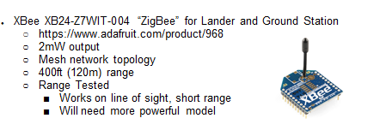
Rover Image Transmission

Slide 50
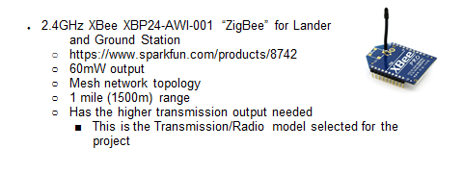
Image Transmission Trade (cont.)

Slide 51
Rover Power
Lander
5 NiMH AA Batteries (7.5V), total of 1,200 to 1,900 mAh
Mechanical Box Encasement
Rechargeable, sufficient power, cost effective
Protection circuits
Arduino - Reverse Polarity Detection/Short Circuit Protection
Tank
2 NiMH AA Batteries

Slide 52
Lander Power Distribution
Lander Electrical Power System Design
Arduino Built-in 5 Volt, 1 Amp Regulator (NCP1117ST50T3G)
Jumper cables for distribution to sensors

Slide 53
Software

Slide 54
Lander Software Design
Software States:
1. Pre-Mission Idle
2. Armed
3. Descent
4. ICST
5. Tank Command
6. Post-Mission Idle

Slide 55
Telemetry

Slide 56
Software Flow Chart
START
Battery
connected
Pre-Mission Idle State
Waiting for “ARM” command to be received from XBee
Armed State
Waiting for large downwards acceleration
Descent State
Images Captured and Stored
30 second Delay
Motor releases parachute
Waiting for distance to ground to measure 10 feet (UTS)
ICST
State
Images Transmitted
Tank
Command State
Tank is Driven by Lander
Post-Mission Idle State

Slide 57
Software Development Plan
Software Development Plan
The purpose of this system is to control the arming of the Lander, release of the parachute from the Lander, the sensing of impact with ground, the capture, storage, and transmission of 4 images, and the deployment and navigation of the Tank.
This software applies to the Arduino MEGA 256 that is on the Lander.
Software is used in tandem with the 2018 York Area Mars Rover Team Ground Station Program which sends the arming signal and processes the images.

Slide 58
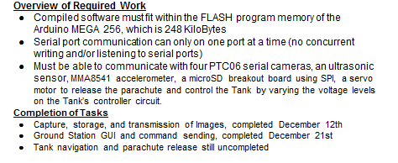
Software Development Plan (cont)

Slide 59
Rover Payload Integration
Foam Sabot
Describe process of payload integration
Rover is turned on, in the Software “Pre-Mission Idle” State, and placed in the sabot which is then placed in the rocket.

Slide 60
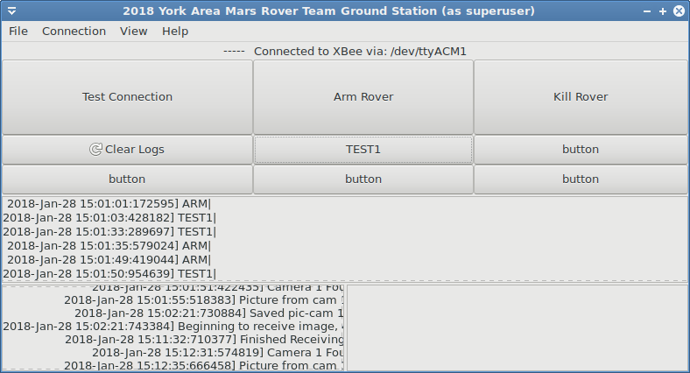
Software Development Plan (cont.)

Slide 61
Software Development Plan (cont)
Ground Station GUI
Python 3.5 program
Utilizes: PySerial, GTK3
GUI designed using Glade
Communicates over serial to the XBee, which then transmits to the Rover XBee
Saves Images received from Rover
Keeps logs of outgoing and incoming data
Can send commands
ARM - Sets the Rover’s software state to the “Armed” State
KILL - Legacy command for previous tank concept (remote kill switch)
Test Commands
“TEST1” - Test of ICST
Test Connection - Sends out “pings” to the Rover and waits for replies. Test connection quality.

Slide 62
Testing

Slide 63
Rover Testing
Subsystem Testing
●Image capture and saving to SD card
●Serial communication over Lander XBee to Ground Station XBee
Integration Testing
●Pre-launch Test Program to check sensors and electronics
Functional Testing
●Programmed Tank Paths
○The Tank path programs are adjusted from test to test to find the best travel path
●Test flight will be done to test if Launch, Descent, and Landing accelerations are recognized/detected
●Test flight to test if proximity to ground is detected accurately

Slide 64
Rocket Testing
Ejection charge test on December 17
One of the bulk heads was damaged on the electronics bay, our design had to be altered
Dec 19 through Jan 16 – Ebay was strengthened by adding two plywood rings and wooden joists separating them. The bulkheads rest and seal against the wooden ring.
Flight test planned for January 13 and 14, cancelled due to weather
Jan 26 – Ejection charges were tested by attaching the rocket to a zipline. Videos to follow.
Next flight test planned for February 17 and 18

Slide 65
Ejection Charge Test (Drogue)

Slide 66
Ejection Charge Test (Main)

Slide 67
Flight Operations
The rocket will have new batteries in the E-Bay before every launch, and before the launch, all altimeters will be tested.
Freshly charged batteries are put in tank and Lander
Test Program is uploaded to Lander to check sensors/connections
The rover will be incorporated into the rocket by being inside a sabot
At the launch pad, the key switches will be turned and arm the electronics bay.
After Rover is placed in payload section:
Arming Button is pressed and prep cycle commences

Slide 68
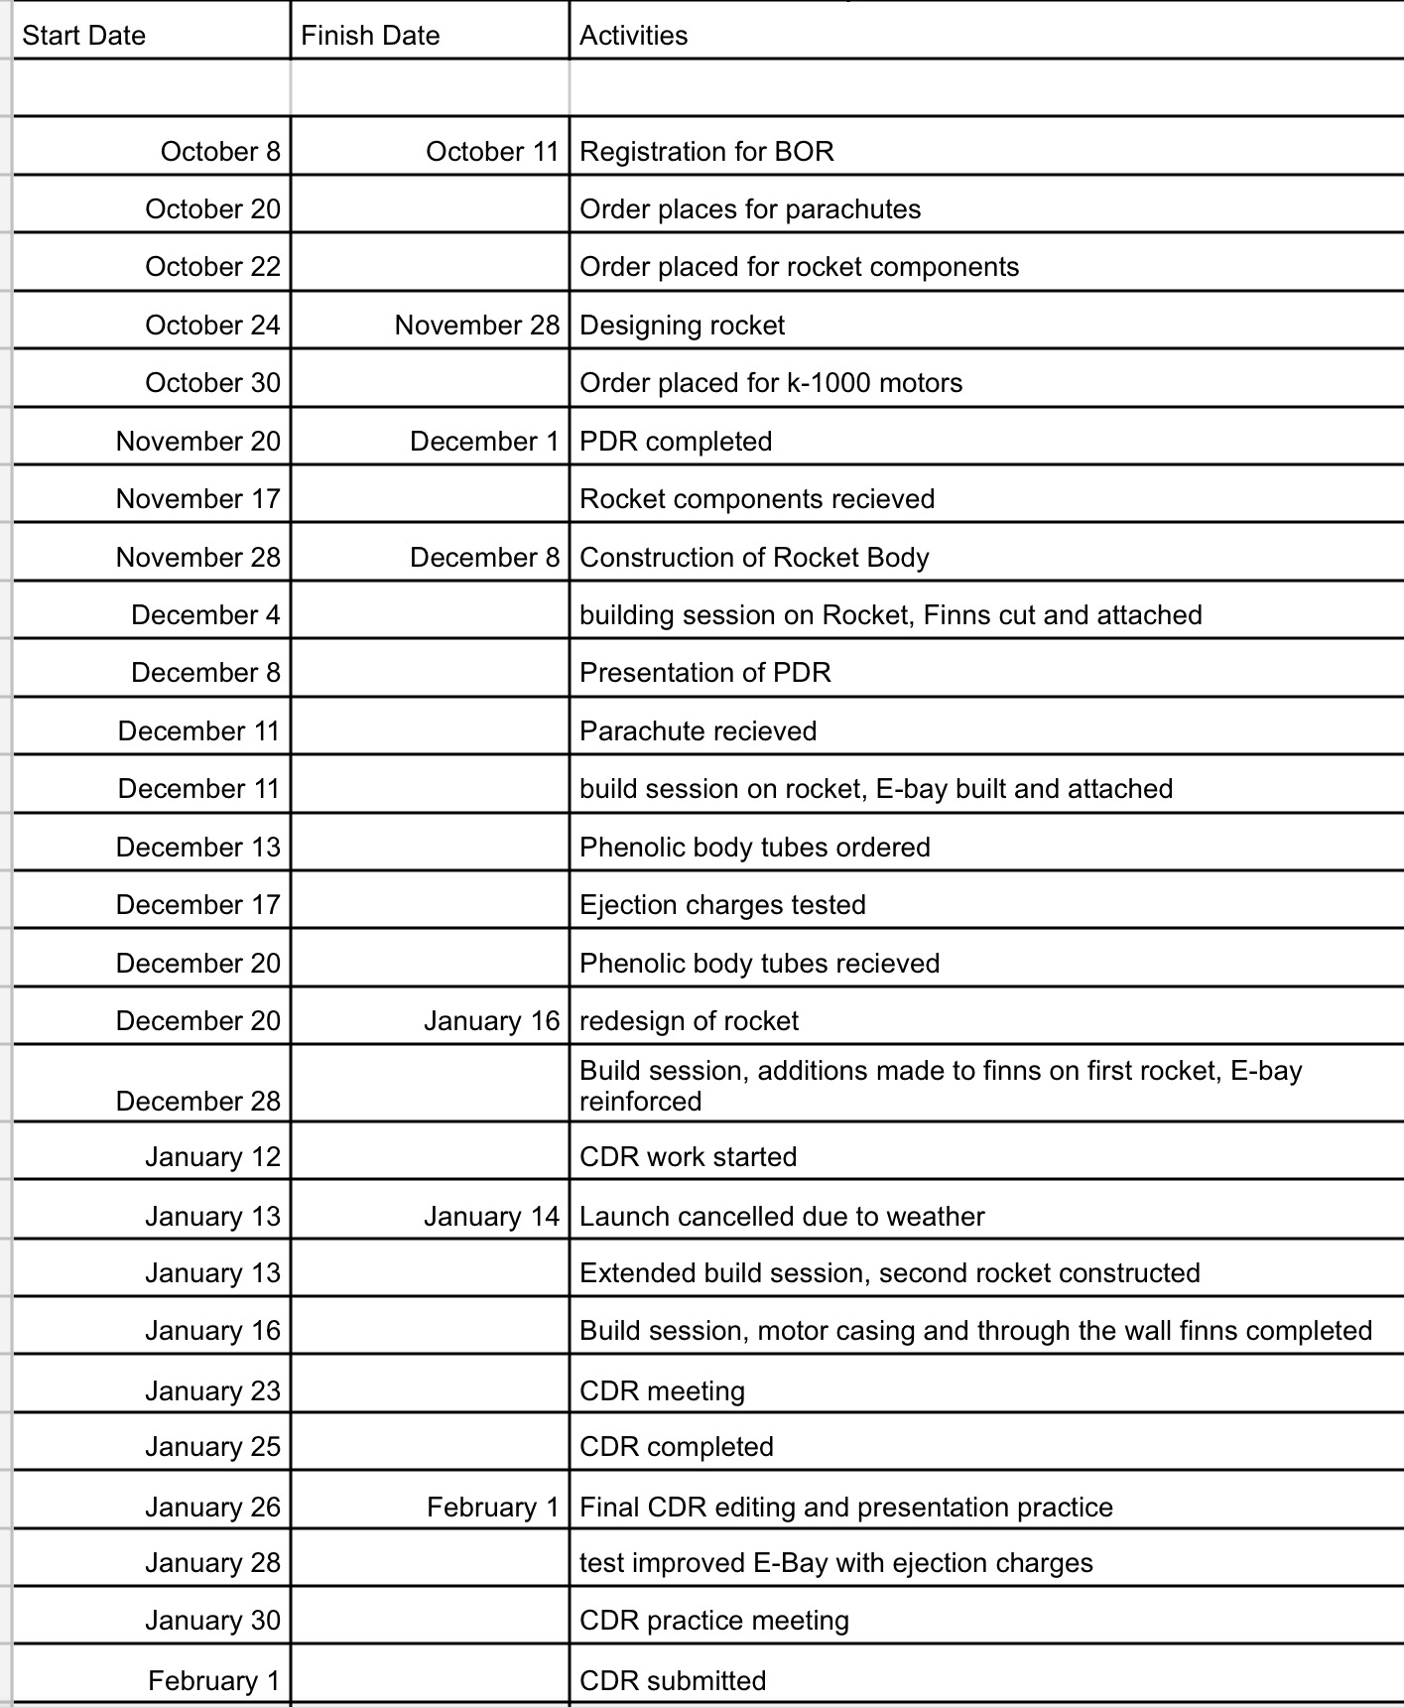
Rocket Program Schedule

Slide 69
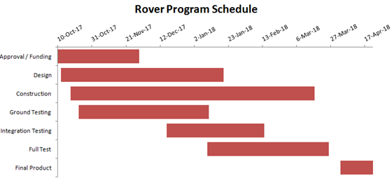
Payload Program Schedule

Slide 70
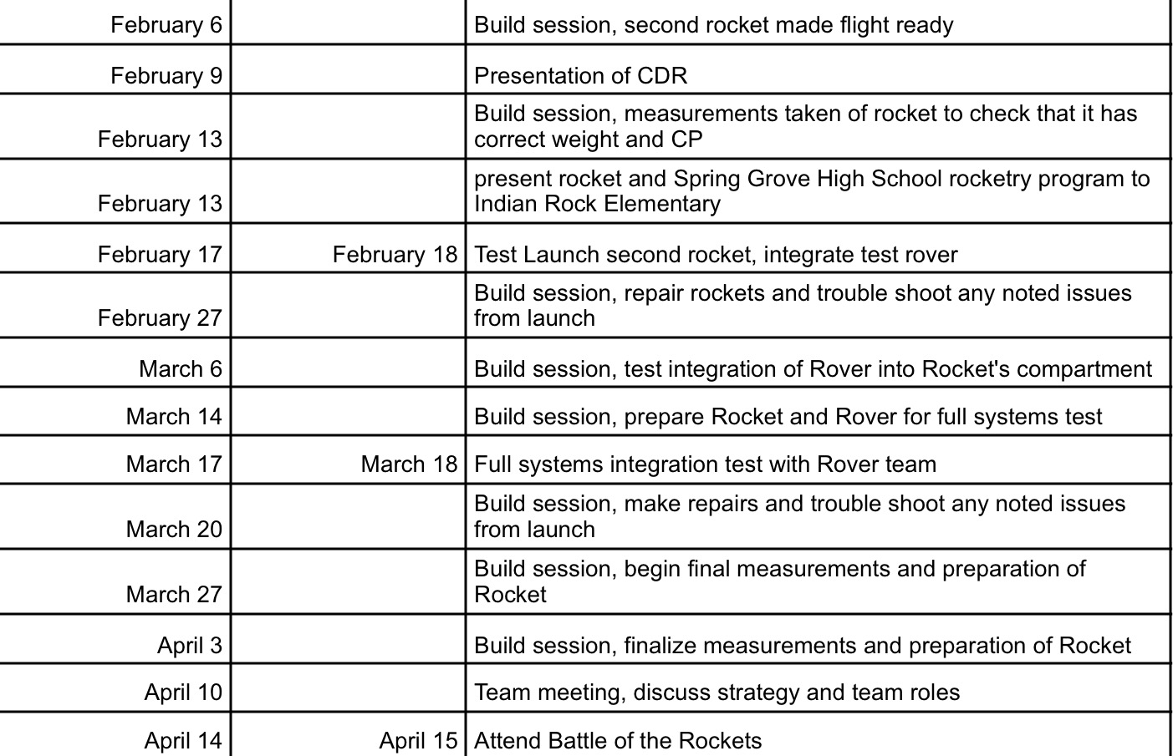
Rocket Program Schedule

Slide 71
Service and Component Schedule
The rockets components were all received on November 17 2017
K-1000 motors were ordered on October 30th, and arrived January 5th
K-1440 motors were ordered January 16 and arrived January 24
Parachutes were ordered October 20th, and arrived December 11th
Phenolic Body tubes were ordered from Public Missiles limited on December 13th and received them December 20th
The body tubes were precut by the company at about the time it was ordered.

Slide 72
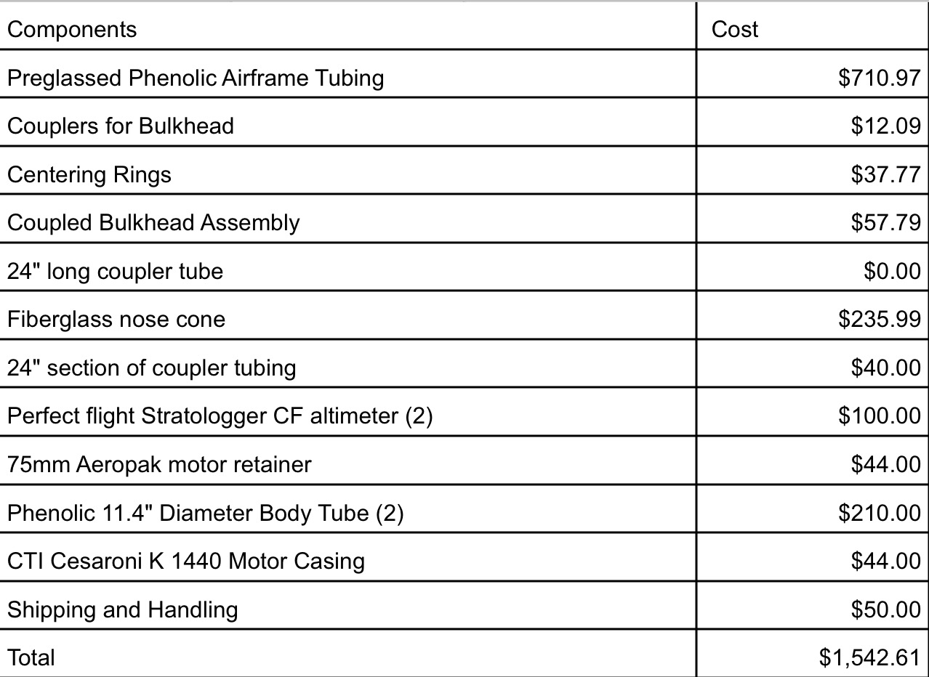
Program Budget
Components

Slide 73
Program Budget
Services

Slide 74
Program Budget
Travel expenses
Grand Total

Slide 75
Program budget cont.

Slide 76
Payload Summary
Development moves very fast, every day new ideas arise and changes/additions are made to the design. Some key accomplishments were successfully transmitting images and successful sensor testing. Some issues we ran into were the legality of our “rover”, material requirements, sensor accuracy, and lander layout. The electronics system is in the process of being constructed into its final form, and the lander and rover designs are beginning to be constructed.

Slide 77
Rocket Summary
Now we are reconstructing the rocket and so far redesigning the rocket has gone well. It's design so the rocket is lighter, fixing the issue with the CG and the CP. We fixed this issue by enlarging the fins so the CP is behind the CG by at least by a caliber. we are almost complete with making the rocket lighter to fix the 5:1 TWR. Thus far the only tests that have been completed on the rocket is an ejection test that was successful but the first flight is scheduled to happen on our pending February launch.

