Slide 1
Team Triton CDR
Members: Sarah, Lacey, Lindsay, Emily, Zach, Adam, Josh and Melody

Slide 2
Changes Since PDR
We have a new member, Josh that works on additive manufacturing
Changes to Vehicle Criteria
The mass changed from 396.09 ounces to 362.00 ounces
We changed our drogue parachute from 30 inches to 24 inches
Rail length changed from 8 feet to 12 feet
The length of the front body tube changed from 27.7500 inches to 46 inches and the back body tube changed from 56.2500 inches to 38 inches.
Changes to Payload Criteria
The solenoid will be controlling a clamp that closes a tube between the two plastic vials.
Changes to Project Plan
We will be launching the full scale rocket on January 14th and 15th, Feb.11th and 12th, and March 11th and 12th.

Slide 3
Safety
Facilities and Equipment
Safety Equipment
Safety Plan
Procedures for NAR/TRA Personnel to Preform
Plan For Briefing Students
Method for Handling and Storage
Team Agreement
Our safety officers is Melody B.

Slide 4
Vehicle Criteria: Flight Reliability and Confidence
Our mission:
Launch a rocket to an altitude of 1 mile
Test effects of G-Forces on Non-Newtonian Fluid
Return safely

Slide 5
Materials
Body tube: Fiberglass
Nose Cone: Fiberglass and Resin
Fins: Ultem
Parachutes: Ripstop nylon
Shock cords: 1” tubular nylon or 7/16” tubular Kevlar
Heat shield: Nomex
Eyebolts: forged steel

Slide 7
Requirements
The rocket is stable, it has an acceptable weight and velocity, and can safely descend.
Stable during flight
Acceptable weight and velocity
Descends safely

Slide 8
Design Integrity
Fin can shape: Three irregular pentagonal fins on a cylindrical sleeve
Sufficient motor mounting with 3 centering rings and Rocketpoxy, and an Aeropack
retainer keep the motor in position and stops it from being moved

Slide 9
Subscale Flight Results
Flight conditions were 45 degrees Fahrenheit , overcast, and wind of about 10 mph
Predicted altitude of 2,403 ft
Actual altitude was 2,303 ft
4.2% difference
Very stable flight, dual deployment worked as planned

Slide 10
Subscale Flight Results
The success of the subscale flight had proven the design and recovery subsystem to be successful.
The success of the subscale flight allowed us to continue with the same design and use the same design for the recovery subsystem.

Slide 11
Recovery Subsystem
Main Chute - 72 Inch Iris Ultra
Compact enough when stored, but large enough to reduce rocket to safe velocity, very large drag coefficient compared to similar elliptical
Opens up more space in the front body tube
Drogue Chute - 24 Inch Elliptical parachute
Decrease in size to reduce drift

Slide 12
Recovery Subsystem
-Main chute attached to shock cord, which is attached to eyebolts on the electronics bay and payload by a quick links
-Payload is attached to the nose cone via pop rivets
-Drogue chute attached to a shock cord, which is attached to eyebolts on the electronics bay and the motor casing.

Slide 13
Recovery Subsystem
Two altimeters
Two 9 Volt batteries
Two sets of ejection charges
There are two of everything in the recovery subsystem to ensure that if failure occurs in one set, the other will activate preventing permanent damage to our rocket. There is a delay of 2 seconds at apogee and 100ft at main chute deployment.

Slide 14
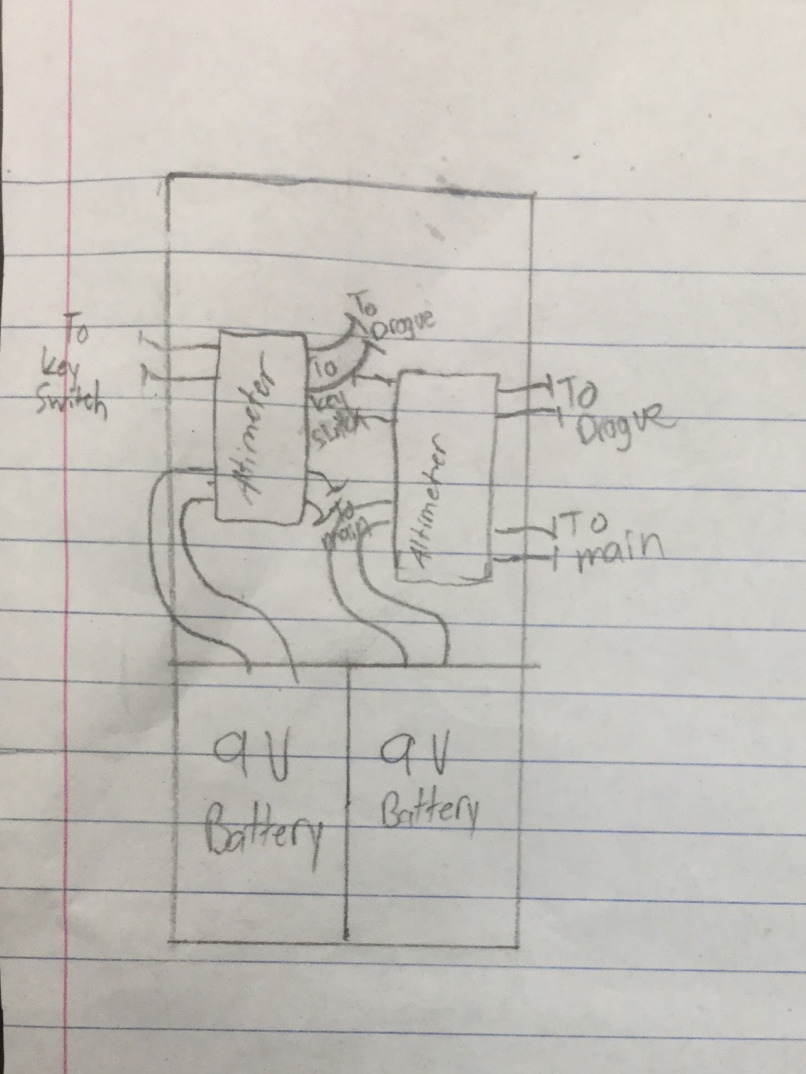
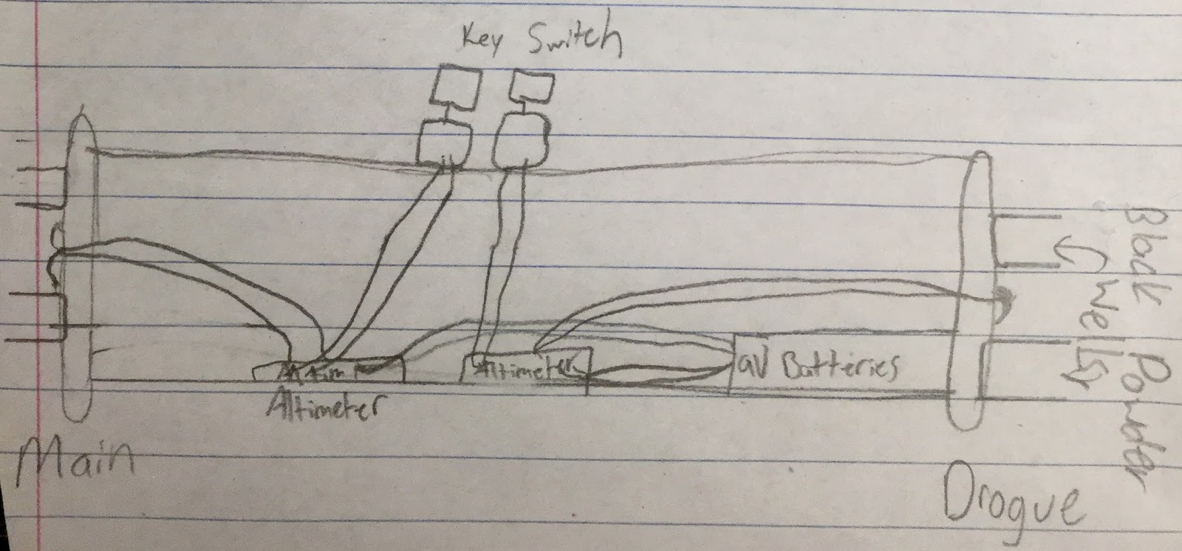
Top View of Electronics Bay
Side View of Electronics Bay

Slide 15
Block Diagram of Main Components

Slide 16
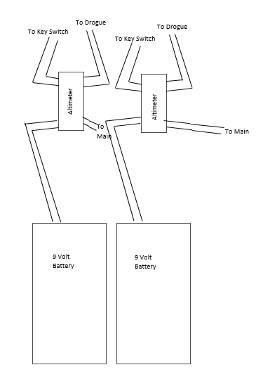
Electrical Schematics
(Inside the Electronics Bay)

Slide 17
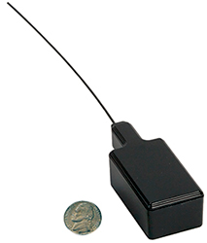
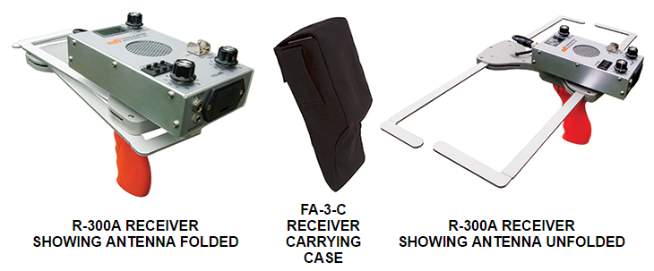
Recovery Subsystem
AT-2B Tracker R-300 A Receiver from Communication Operating Frequency is 222.270 Specialists Inc.

Slide 18
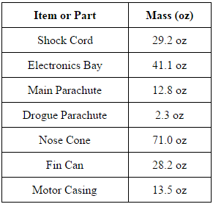
Mission Performance Predictions

Slide 19
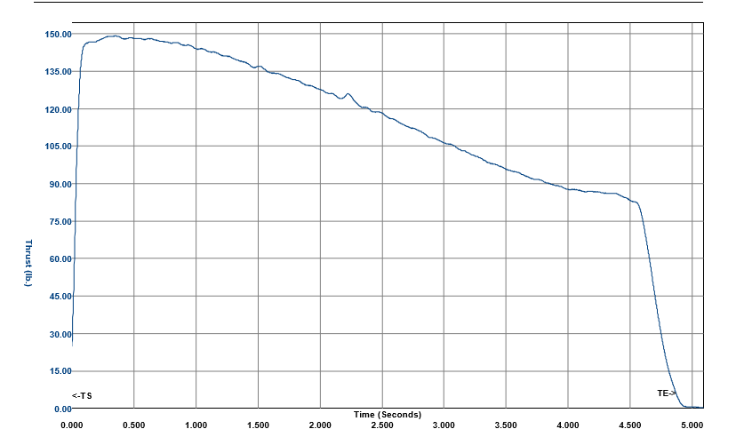
Motor Thrust Curve
The simulated apogee is estimated to be about 5365 ft, If the percent difference is linear, then the actual predicted height should be about 5140 ft.

Slide 20
Mission Performance Predictions

Slide 21
Mission Performance Predictions
Kinetic Energy

Slide 22
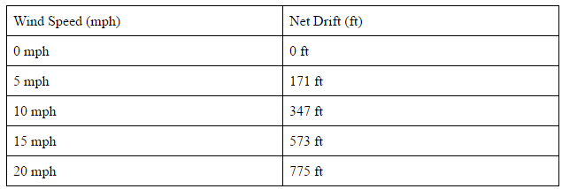
Mission Performance Predictions

Slide 23
Payload
This year we are testing a colloid’s (oobleck) reaction to the G-forces acting on it during accent.
Oobleck properties:
Solidifies when pressure is acting on it
Liquidities when no pressure is applied to it

Slide 24
Payload Design
The final configuration will include a NI-MH battery, rotary arming switch, G-switch, latching relay, a timer, two plastic test tubes and a solenoid. When the rocket comes off the launch pad, the G-switch will close sending power the latching relay which will then send power to a timer adjusted to match the vertical ascent time or less. The timer will send power to the solenoid to open the path between the two test tubes. The oobleck in the top test tube will either drain to the bottom or stay in the top tube. The solenoid valve will then close when the timer stops and the data will be collected when retrieved. If there is room, cameras will be added in the payload section to record the event. This will add to the data collected in this experiment by visually showing what happens to the colloid when G-forces are applied.

Slide 25
Payload Housing
The experiment will be housed in separate compartment, similar to the ebay housing, in the nose cone and extended out into the rocket’s body.
14 inches and will be attchedto the nose cone using 4 plastic pop rivets
Sheer pins will be used to hold the experiment housing to the body tube and will break during ejection
Eyebolt will be mounted on one of the fiberglass end caps of the payload
This cap will have a U-bolt screwed on the outside of the cap, connected with a quick link to the main parachute
A wooden piece (the sled) will be secured perpendicular to the inner part of the disk/cap allowing the solenoid valves to be removable

Slide 26
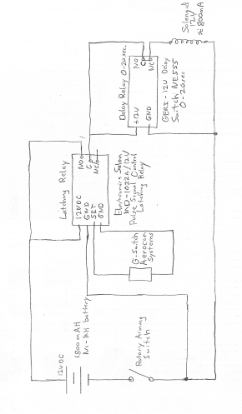
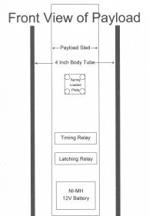
Payload Drawlings
Electronics circuit

Slide 27
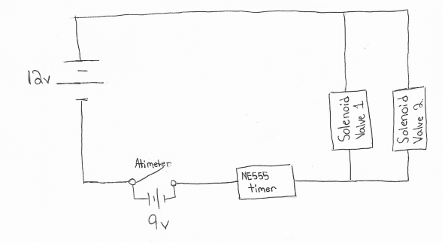
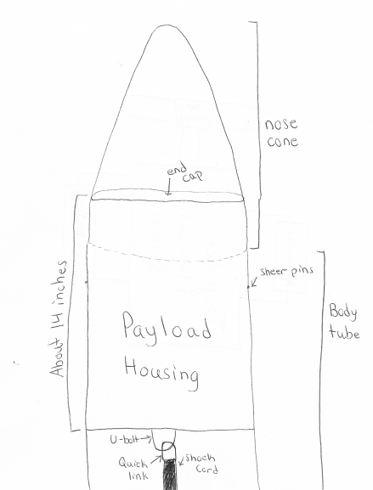
Alternative Payload Electronics System

Slide 28
Challenges and solutions
Challenge | Solution
Keeping the oobleck mixed. | Mix the two parts cornstarch and one part water to make the colloid within an hour or less before the rocket is taken out to the payload. This will keep the colloid mixture from separating and losing its properties.
The motor selection will determine the length of the of time the rocket accelerates effecting the time of our experiment | We can use RockSims to get an estimation on the time of our rockets acceleration, so we can then set the timer for our experiment.
Determine the optimum dimeter of our test tubes. | If the test tubes are too big and the colloid might solidify under the G-forces, causing the colloid to drop to the bottom test tube. If the test tube is too small then the colloid might stay in a solidified state casing not change during the rockets accent. We can solve this by trial and err or by placing a small ring in the top test tube so when the solenoid valve opens the colloid either turns into a liquid and flows through the hole, or the colloid stays in the top tube do to a solid state of matter.
Getting all electronics to work together at the same time. | In order to insure that all electronics work together at the same time the electronics will be test prior to flight. We also have two of each electronics (solenoid valve and camera) in the nose cone, if in the event that one of the electronics fails to work we have a back up to collect the data.
Creating a rocket that won’t go over 5280 feet. | Design the rocket to fly one mile high or slightly over under perfect conditions. This is accounted for the highly probable that the rocket will weigh 25 percent more than calculated values. Therefore in experimental launches you will have consider all factors like air resistance (that will cause drag) and modify as needed.

Slide 29
Launch Operations Procedures
Recovery Preparation
Motor Preparation
Setup on launcher
Igniter installation
Launch procedure
Troubleshooting
Post-flight inspection

Slide 30
Testing
Subscale Flight
What we learned?
Ground Test for ejection charge
Ground Test for payload
Full-scale Flight

Slide 31
Flight results
These two flights were performed without the payload components (approximately 12oz). There is a concern that with the completed payload the thrust to weight ratio will drop below 5.0. If so, we will submit a request to change components to reduce mass or to change the motor to one with a higher average force (Possibly the K661 Blue Streak – another 2 Grain 75mm CTI motor,
other options include the Aerotech K560W or the CTI K711WH)
The first rocket went 5903 feet
It reached a maximum velocity of about 680 ft/s
The drogue parachute ejected at apogee
The main parachute ejected at 700 ft
Sunny and barely any wind
The second rocket went 5746 feet
It reached a maximum velocity of about 650 ft/s
The drogue parachute ejected at apogee
The main parachute ejected at 700 ft
Cloudy, and the wind was 10-15 mph

Slide 32
Funding
Cotton Candy
Roctopi
Bonus Books
Paint night
Avon
Nuts about Granola
We have raised approximately $17,000

Slide 33
Grants and Donations
TE Connectivity for $7,500
Pennsylvania Space Grant Consortium for $2,500
National Association of rocketry (NAR) Cannon Award for $500
Engineering Society of York for $1,000
Hanover Rotary for $1,000
M&T Bank for $1,250
Spring Grove Educational Fund for $1,000
Rutter’s for $250 and another donation for $100.
OK Associates donation of $500
Maryland Delaware Rocketry Association $250

Slide 34
Budget
It went up $4500 because we had to replace some tools and purchase some more consumables during the construction of the subscale and the full scale.

Slide 35
Gantt Chart

Slide 36
Education Engagement
Elementary students will receive a more basic understanding of the TARC and SLI programs we have here at Spring Grove Area High School
Intermediate and Middle School students will receive a more in-depth educational experience of the TARC and SLI programs to get them interested in participating in the SLI and TARC programs when they reach the High School.

Slide 37
Educational Engagement
Presentation at the Intermediate and Middle Schools
The SLI team will present our project and rocket design and payload
A survey sheet will also be given out to the students in order for us to get feedback on what we did well and what we can improve on for following years
This Presentation will inform the younger generation about the SLI programs and help insure the continuation of this program.
Rocket workshop
Parent meeting- information about the rocket workshop
Sign ups for the workshop will be in the guidance office
The workshop will be in scheduled in March based on the weather and interest
A hands on experience will further explain what SLI does while giving the kids a new aspect rocketry.

Slide 38
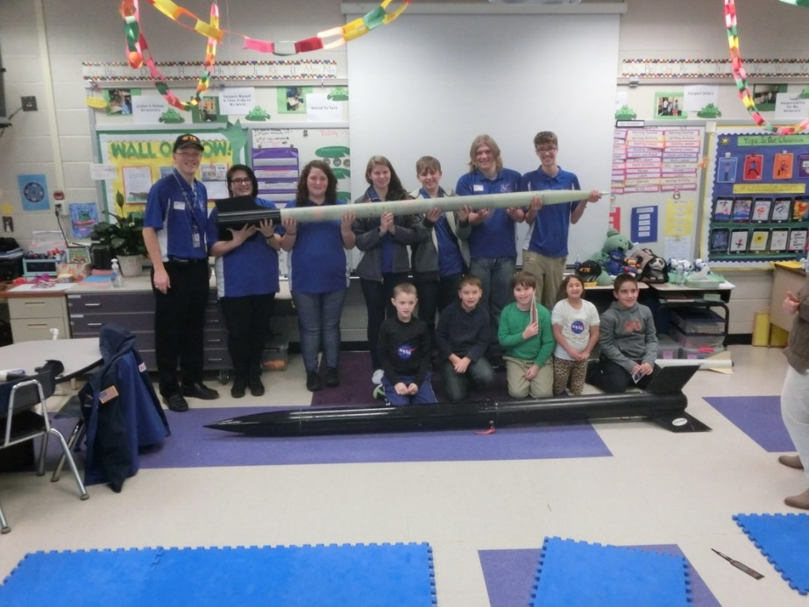
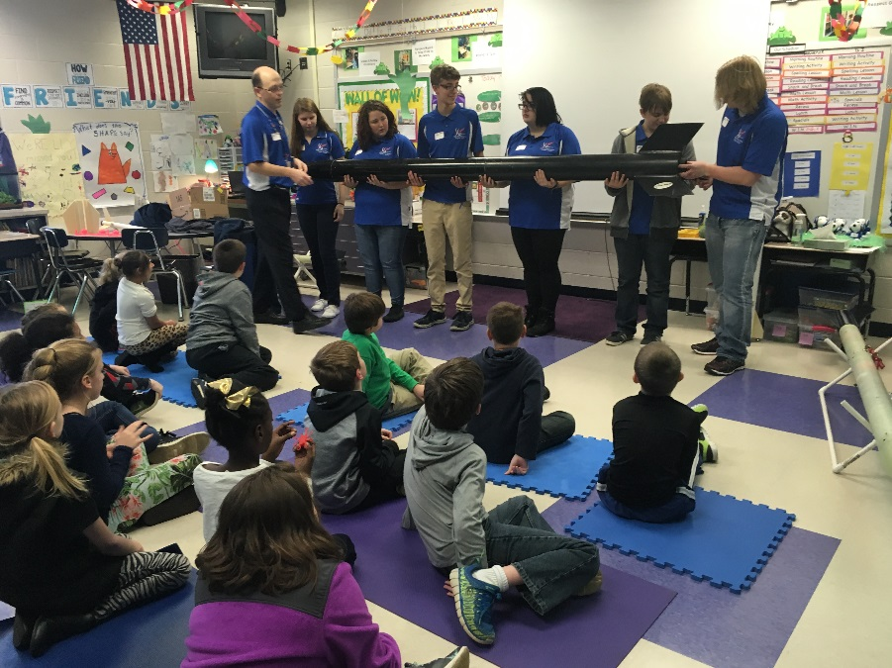
Visit to West Manheim Elementary School
We talked to kids in grades 2-4
Our visit there was beneficial to us and the kids
We talked about the parts of the rocket and how they work
They seemed very interested since they asked many questions
We took in our full-scale and sub-scale rockets
We showed pictures and videos of recent launches

Slide 39
Subscale Ejection Charge tests
Tested with all shock cords, parachutes and motor casing.

Slide 40
Subscale Launch video
Very stable subscale

Slide 41
Full Scale Launch flight 1
Trident rocket filmed at full speed

Slide 42
Full Scale Launch flight 2
Trident filmed at 240fps

