Slide 1
Team Triton FRR
Members: Sarah, Lacey, Lindsey, Emily, Zach, Adam, Josh and Melody

Slide 2
Changes Since CDR
Went from 50’ of 1’’ tubular nylon shock cord to 50’ of ½ tubular Kevlar
A key switch was installed on the bulkhead of the payload.
We have requested to change the motor from the CTI K510 to the CTI K711
Thus to increase the thrust to weight ratio
But due to the delay in getting approval from CTI..
We formally request to sue an Aerotech 75mm 2 grain K1000 motor instead of the k711
We are changing this because we are afraid we wont get approval in time for our launch on March 11th
We have tested this motor on February 11th
- It flew at 5455 ft and its 4oz lighter than the final configuration

Slide 3
Changes since CDR
We have switched from a K510, to a K1000 motor to increase the thrust weight to ratio.
We have also changed the Nylon shock cord to a Kevlar shock cord because the kevlar is heat resistant, stronger, and less bulky.
We switched our drogue chute from a 24in to a 15in to decrease the descent time in order to decrease the drift distance.

Slide 4
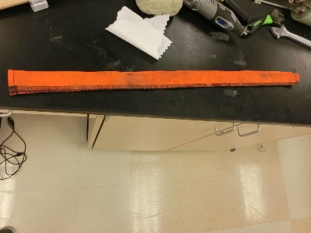
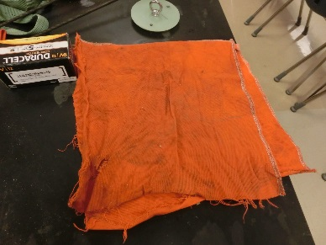
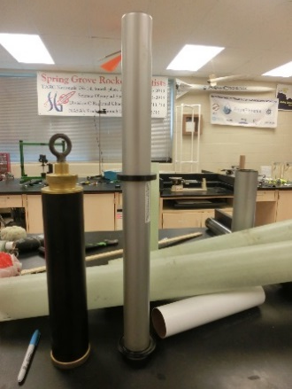
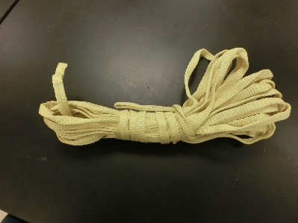
Heat Shield(Shock cord)
Heat Shield(Parachute)
Motor Casing(Aerotech K1000 left, CTI K711 right)
Shock Cord(Kevlar)

Slide 5
Structural Elements
Launch Lugs: They guide the rocket along the launch rail
Body Tube Sections: These are the main structure of the rocket
Nose Cone: This reduces the drag on the rocket and allows it to fly straight
Fin Can: This provides stability for the rocket and reduces drag
Parachutes: These slow the rocket to a reasonable speed during descent.
Shock Cord: These limit the separation of the sections
Motor Retainer: This holds the motor in place

Slide 6
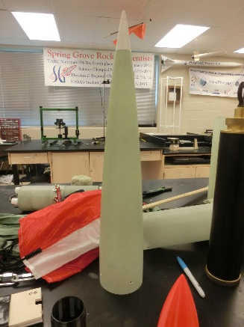
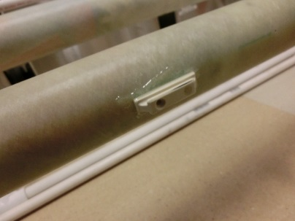
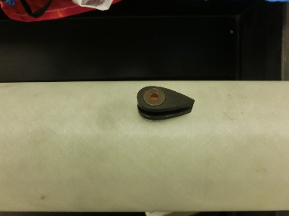
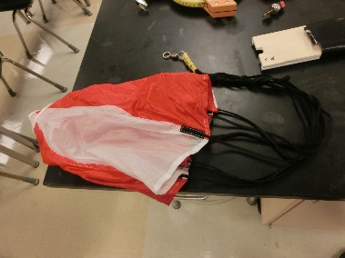
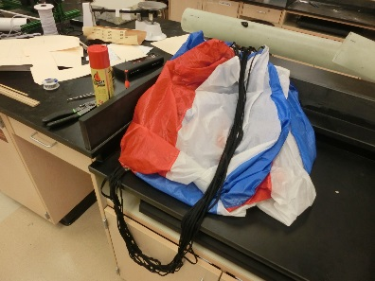
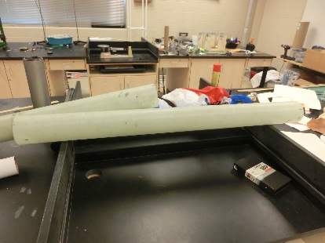
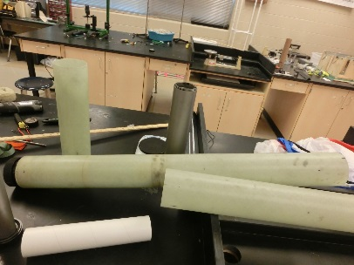
Structural parts
/\ Drogue chute /\ Main chute
| | | |
Nose cone \/ Fin can \/
/|\ /|\
\___________ Launch Lugs_______/
___________
Body tube sections / \
\|/ \|/

Slide 7
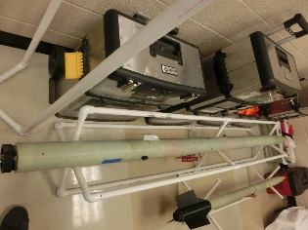
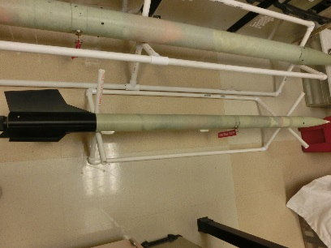
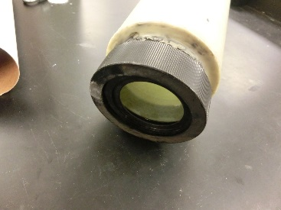
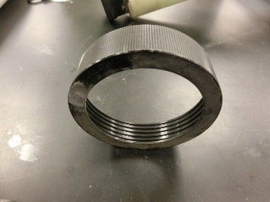
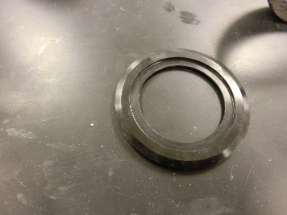
/|\
\____________ Full Scale Rocket
_________________Motor Retainer + Cap______________
/ | \
\|/ \|/ \|/
Sub Scale Rocket

Slide 8
Electrical Elements
Key Switches: Allow the rockets to be armed and disarmed
Altimeter: Tracks the altitude and speed of the rocket as well as well as controls the parachute ejections
Ejection Wells: Holds the black powder until it is ignited by altimeter

Slide 9
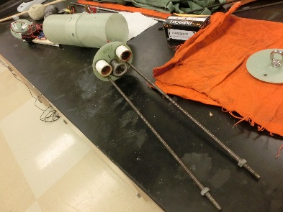
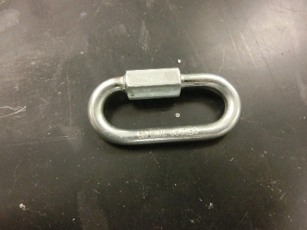
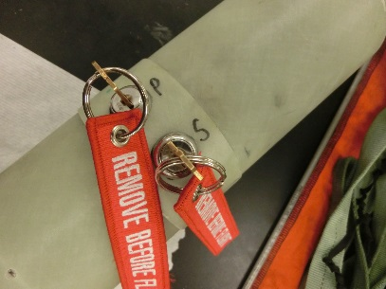
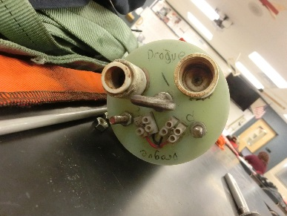
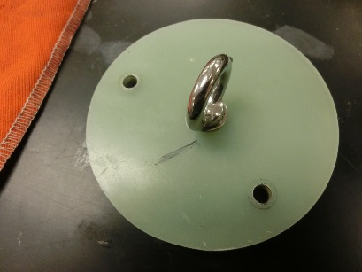
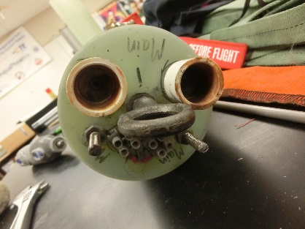
Electronics
Bay
All-Thread Rods
Quick Links
Key Switches
Ejection Wells for Drogue
End Cap of Payload
Ejection Wells for Main

Slide 10
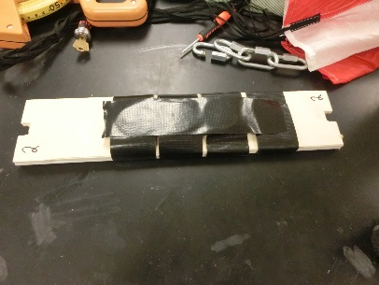
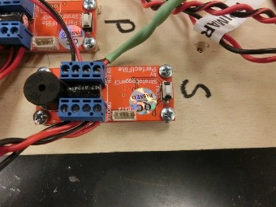
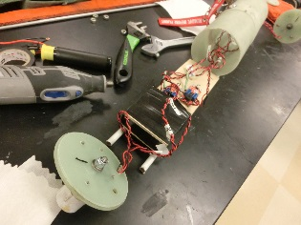
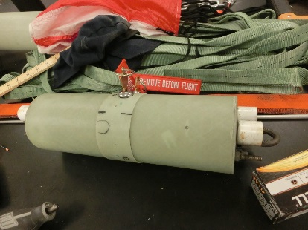
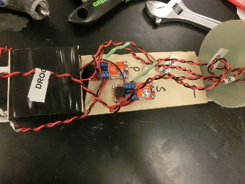
Simulated Payload
Altimeters(Primary and Secondary)
Electronics Bay
Wiring of the Electronics Bay

Slide 11
Construction Process
Cut body tubes to length
Work on Electronics bay
Electrical assembly and wiring
Attach shock cords and parachutes
Prepared payload
Prepared rocket motor

Slide 12
Flight Reliability
The rockets have proven design and are expected to reach the desired altitude.

Slide 13
Subscale Flight Results
Flight conditions were 45 degrees Fahrenheit , overcast, and wind of about 10 mph
Predicted altitude of 2,403 ft
Actual altitude was 2,303 ft
4.2% difference

Slide 14
Subscale Flight Results
The success of the subscale flight had proven the design and recovery subsystem to be successful.
The success of the subscale flight allowed us to continue with the same design and use the same design for the recovery subsystem.

Slide 15
Recovery System

Slide 16
Structural Elements
Held together by shear pins, which will allow sections to separate
Connects back body tube to the electronics bay, and the nose cone and payload to the front body tube.
It is also held together by pop rivets, which will hold sections together
At connections between the front body tube and the electronics bay, and as well as the connection between the nose cone and the payload.
Within the rocket, sections are held together by shock cord.
Shock cord is attached to bulkheads via quick links in the payload, electronics bay, and an eyebolt on the motor casing

Slide 17
Electrical Elements
Two Perfectflite altimeters
Two 9-Volt Batteries
Two key switches outside of the elrctronics bay
The key switches are turned, providing power to the altimeters via the 9-Volt batteries

Slide 18
Redundancy Features
Redundancy exists within the recovery subsystem
A primary and secondary altimeter
One 9-Volt battery per altimeter
Two key switches; one arms the primary altimeter, one arms the secondary altimeter

Slide 19
Parachute Sizes and Descent Rates
15 inch Elliptical drogue ejects at apogee, and slows rocket to 132.25 ft/s by 600 ft
72 inch Iris Ultra main ejects at 600 ft, and slows rocket to landing speed of 16.71 ft/s

Slide 20
Drawings and Schematics of the as built Electrical and Structural Assemblies

Slide 21
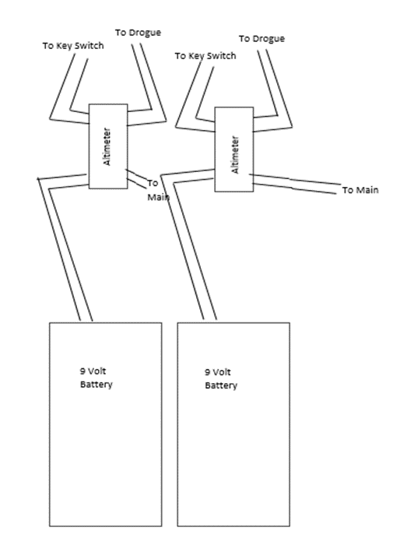
Schematic of Inside Electronics bay

Slide 22
Diagram of Rocket Components

Slide 23
Rocket Locating Transmitters
AT2B Communication Specialists Inc. tracker
Operating Frequencies of 222.470 and 223.530
Wattage of 50 milliwats
Range of about 5 miles

Slide 24
Recovery Subsystem Sensitivity
The Recovery Subsystem has no additional features that will be affected by an electromagnetic field
Perfectflite Altimeter is only affected by air pressure
Payload not expected to be affected by an electromagnetic field

Slide 25
Mission Performance Criteria
Our mission is to launch a rocket to an altitude of one mile while testing the effects of G-forces on a Non-Newtonian fluid. In order for our mission to be successful, our rocket must reach an altitude of one mile, and safely return.

Slide 26
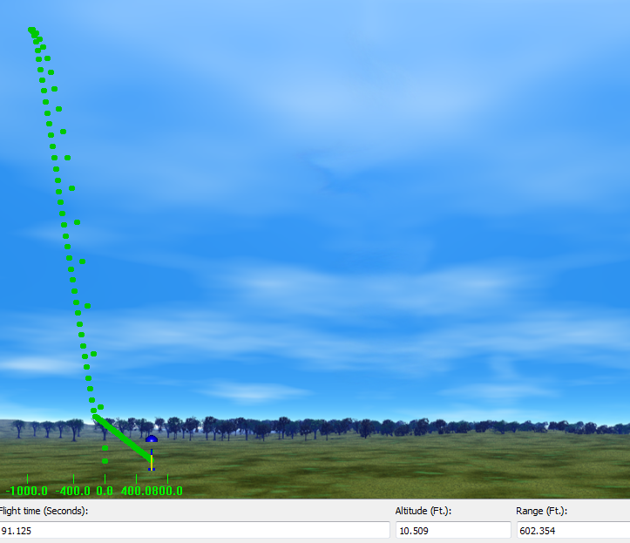
Flight Profile Simulations

Slide 27
Altitude Predictions
The predicted result of the full scale flight was that the rocket would apogee at about 5580 feet.

Slide 28
Component Weights
Item | Weight
Nose Cone | 71.96 oz
Body Tube | 59.20 oz
Shock Cord | 29.20 oz
Electronics Bay | 41.10 oz
Main Chute | 12.80 oz
Drogue Chute | 2.30 oz
Fin Can | 28.20 oz
Payload | 16.30 oz

Slide 29
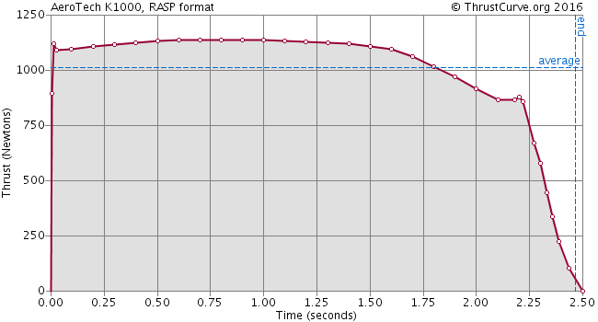
Motor Thrust Curve

Slide 30
Drag Assessment
The main parachute will create a drag force of 727.12 Newtons
The drogue parachute will create a drag force of 95.04 Newtons

Slide 31
Scale Model Results
Flight conditions were 45 degrees Fahrenheit , overcast, and wind of about 10 mph
Predicted altitude of 2,403 ft
Actual altitude was 2,303 ft
4.2% difference
Very stable flight, dual deployment worked as planned

Slide 32
Predicted vs. Actual Data
The predicted result of the full scale flight was that the rocket would apogee at about 5520 feet.
The actual result of the full scale flight was that the rocket would apogee at BLANK feet.

Slide 33
Two-Dimensional Model

Slide 34
Kinetic Energy
We will be controlling the kinetic energy by the use of a 72 inch FruityChutes parachute and a 15 inch FruityChutes parachute.

Slide 35
Drift
Wind Speed (mph) | Drift Distance (ft)
0.0 | 0.00
5.0 | 64.88
10.0 | 130.27
15.0 | 633.12
20.0 | 916.17

Slide 36
Full Scale Launch Conditions
Sunny, about 40º F, 10-15 mph wind, and partly cloudy

Slide 37
Simulation of Launch Day

Slide 38
Drag Coefficient of Full Scale
Under no parachute, the drag coefficient was about 0.72
Under the drogue parachute, the drag coefficient was about 1.10
Under the main parachute, the drag coefficient was about 2.20

Slide 39
Payload
This year we are testing a colloids (oobleck) reaction to the G-forces acting on it during accent.
Oobleck properties:
Solidifies when pressure is acting on it
Liquidities when no pressure is aliped to the matter

Slide 40
Payload Design
The final configuration will include a NI-MH battery, rotary arming switch, G-switch, latching relay, a timer, two test tubes and a solenoid. When the rocket comes off the launch pad, the G-switch will close sending power the latching relay which will then send power to a timer adjusted to match the vertical ascent time or less. The timer will send power to the solenoid to open the path between the two test tubes. The oobleck in the top test tube will either drain to the bottom or stay in the top tube. The solenoid valve will then close when the timer stops and the data will be collected when retrieved. If room cameras in the rocket will add to the data collected in this experiment by visually showing what happens to the colloid when G-forces are applied.

Slide 41
Payload Housing
The experiment will be housed in separate compartment, similar to the ebay housing, in the nose cone and extended out to the rockets body.
14 inches and will be glued to the nose cone
Sheer pins will be used to hold the experiment housing to the body tube and will break during ejection
Mounted on one of the fiberglass caps
This cap will have a U-bolt screwed on the outside of the cap, connected with a quick link to the main parachute
A wooden piece (the sled) will be secured perpendicular to the inner part of the disk/cap allowing the solenoid valves to be removable

Slide 42
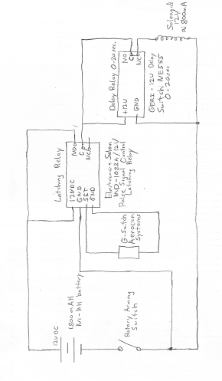
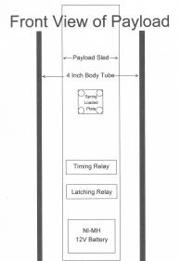
Payload Drawlings
Electronics circuit

Slide 43
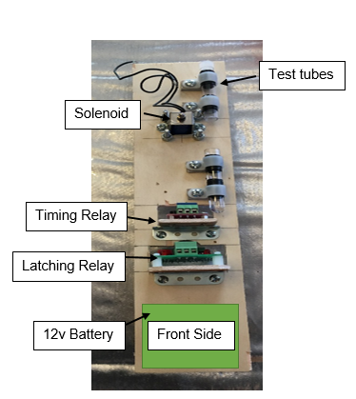
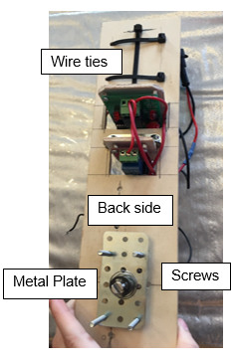
Pictures of Payload

Slide 44
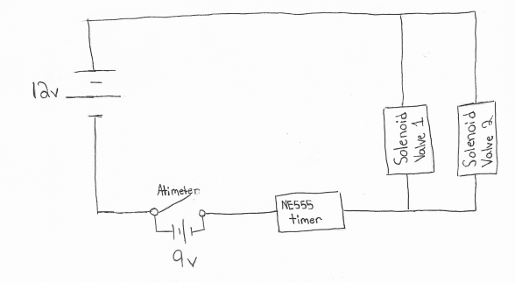
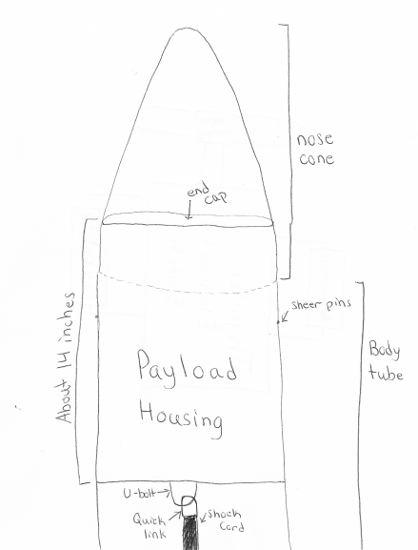
Alternative Payload Electronics System

Slide 45
Challenges and solutions
Challenge | Solution
Keeping the oobleck mixed. | Mix the two parts cornstarch and one part water to make the the colloid within an hour or less before the rocket is taken out to the payload. This will keep the colloid mixture from separating and losing its properties.
The motor selection will determine the length of the of time the rocket accelerates effecting the time of our experiment | We can use RockSims to get an estimation on the time of our rockets acceleration, so we can then set the timer for our experiment.
Determine the optimum dimeter of our test tubes. | If the test tubes are too big and the colloid might solidify under the G-forces, causing the colloid to drop to the bottom test tube. If the test tube is too small then the colloid might stay in a solidified state casing not change during the rockets accent. We can solve this by trial and err or by placing a small ring in the top test tube so when the solenoid valve opens the colloid either turns into a liquid and flows through the hole, or the colloid stays in the top tube do to a solid state of matter.
Getting all electronics to work together at the same time. | In order to insure that all electronics work together at the same time the electronics will be test prior to flight. We also have two of each electronics (solenoid valve and camera) in the nose cone, if in the event that one of the electronics fails to work we have a back up to collect the data.
Creating a rocket that won’t go over 5280 feet. | Design the rocket to fly one mile high or slightly over under perfect conditions. This is accounted for the highly probable that the rocket will weigh 25 percent more than calculated values. Therefore in experimental launches you will have consider all factors like air resistance (that will cause drag) and modify as needed.

Slide 46
Safety
Facilities and Equipment
Safety Equipment
Safety Plan
Procedures for NAR/TRA Personnel to Preform
Plan For Briefing Students
Method for Handling and Storage
Team Agreement
Our safety officers is Melody B.

Slide 47
Safety and Environment
Potential failures in the proposed rocket (changes since CDR)
Parachute deployment failure
Attaching the parachute protection pocket to shock cord
Potential environmental factors that could damage the payload:
Gusts of wind
High humidity
Rain
Wet landing surfaces such as ponds or lakes

Slide 48
Launch Operations Procedures
Recovery Preparation
Motor Preparation
Setup on launcher
Igniter installation
Launch procedure
Troubleshooting
Post-flight inspection

Slide 49
Testing
Sub-scale
Successful and stable
The mass was not changed
The motor was not changed
Ejection Charge for full scale rocket
Too energetic drogue charge
Shock cord was too short on the drogue as well
Shock cord was lengthened and the drogue charge reduced
Overall the test was successful

Slide 50
Testing cont.
1st Full-Scale Launch weekend
Didn’t use a payload or replacement mass
Trust to weight ratio was low
Height was high
2nd Full-Scale Launch weekend
Tested three different motors, K711, K560, K1000
Simulated payload that was 16oz
All three launches were successful

Slide 51
Requirements Compliance
Verification of all plans is needed in the form of a checklist
We will launch our rocket numerous times to ensure safety and ability
We will have a set of minimal requirements in the checklist to once again ensure safety and ability of our project

Slide 52
Funding
Cotton Candy
Roctopi
Bonus Books
Paint night
Avon
Nuts about Granola
We have raised 16,000

Slide 53
Grants and Donations
TE Connectivity for $7,500
Pennsylvania Space Grant Consortium for $2,500
National Association of rocketry (NAR) Cannon Award for $500
Engineering Society of York for $1,000
Hanover Rotary for $1,000
M&T Bank for $1,250
Spring Grove Educational Fund for $1,000
Rutter’s for $250 and another donation for $100.

Slide 54
Budget
It went up $4500 because we had to change and add some new materials.

Slide 55
Gant Chart

Slide 56
Education
Elementary students will receive a more basic understanding of the Tark and SLI programs we have here at Spring Grove Area High Schoo
intermediate and middle school students will receive a more in-depth educational experience of the TARC and SLI programs to get them interested in carrying on into the SLI and TARC programs when they reach the h

Slide 57
March Full Scale Launch
On March 11 the rocket were tested with the new motor and drogue parachute
The altitudes achieved were 5237ft and 5233ft
On March 11th, it was 35º and 10 to 15 mph

Slide 58
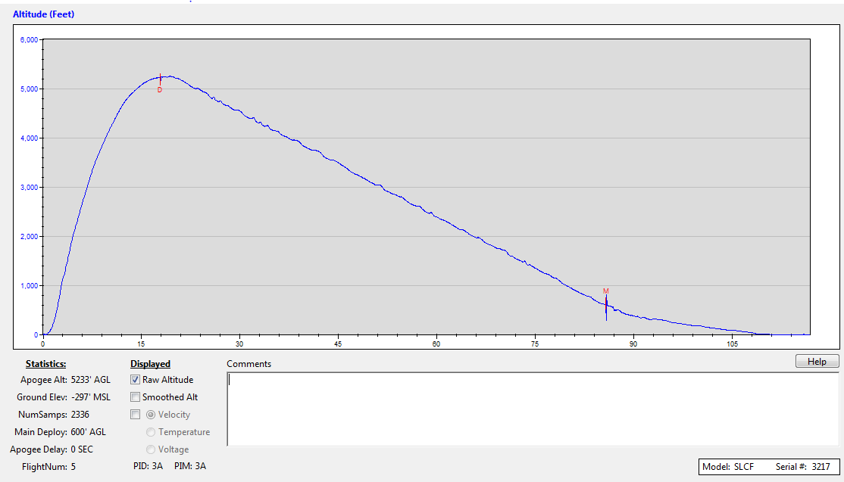

Slide 59
