Slide 1
Team Triton PDR
Members: Sarah, Lacey, Lindsey, Emily, Zach, Adam, Josh and Melody

Slide 2
Changes since Proposal
There have not been many changes since the proposal, the team has not had the chance to start the construction side of the project. For now, the plan remains the same. The measurements, scientific experiment, and schedule will remain the same until further notice. The only remote change made was to slightly increase the budget, to act as a safety blanket in case anything would go terribly wrong. Anything else will remain the same, the safety precautions taken and the original plan will remain unchanged.

Slide 3
Safety
Facilities and Equipment
Safety Equipment
Safety Plan
Procedures for NAR/TRA Personnel to Preform
Plan For Briefing Students
Method for Handling and Storage
Team Agreement
Our safety officers is Melody B.

Slide 4
Vehicle Criteria
Our mission is to successfully launch our rocket to an altitude of one mile, while testing how a non newtonian fluid reacts to the G-forces acting on it during flight.

Slide 5
Rocket Dimensions
105.18 inches long
4.00 inch diameter
Weighs 396.10 oz
Made of Fiberglass

Slide 6
Engine
Cesaroni K510 Classic
390 oz before burn, and 348 oz after burn
115.47 lbs of thrust
1670.53 ft lbs per second
Thrust of 667.24 lbs
Thrust to weight ratio of 4.65

Slide 7
Stability
Center of Pressure: 82.96 from nosecone
Center of Gravity: 53.71 from nosecone
Stability Margin: 7.31
Rail:
96 inches long
15 15 rail size
Exit Velocity of 50.901 ft/sec

Slide 8
Body Material
Fiberglass
Affordable and durable
Phenolic
Cheap and brittle
Carbon Fiber
Durable, yet expensive.

Slide 9
Component Masses

Slide 10
Motor
Cesaroni K510 Classic
75mm diameter
13.78 inches long
Average thrust is 513.64 Newtons
Impulse of 2486.02 Newton-Seconds
Will burn for 4.84 seconds

Slide 11
Parachutes
Main Parachute
72 inch diameter
Ejected at 600 feet
Iris Ultra by FruityChutes
Drogue Parachute
30 inch diameter
Ejected at apogee
Elliptical by FruityChutes

Slide 12
Redundancy
Two altimeters
Two batteries
Two sets of ejection charges
We have two of everything within the recovery system in the event that something goes wrong with one, preventing damage to our rocket.

Slide 13
Flight Simulations

Slide 14
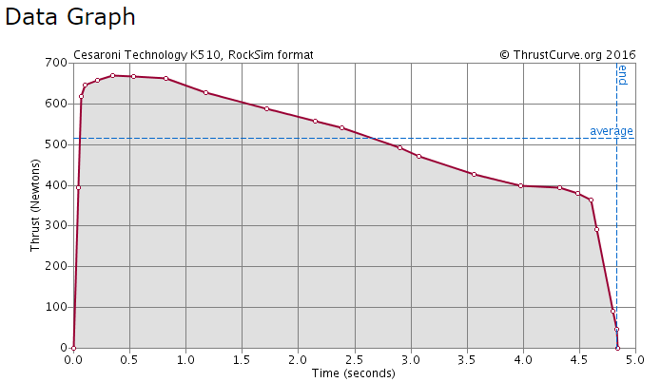
Motor Thrust Curve

Slide 15
Kinetic Energy

Slide 16
Drift

Slide 17
Payload
This year we are testing a colloids (oobleck) reaction to the G-forces acting on it during accent.
Oobleck properties:
Solidifies when pressure is acting on it
Liquidities when no pressure is aliped to the matter

Slide 18
Payload Design
The final configuration will include one altimeter, one DC 12 volt battery, two solenoid valves, if room two cameras, a NE555 timer and two test tubes. When the rocket comes off the launch pad, the altimeter will close staring the timer and opening the solenoid valve for how many seconds we adjust it to. The oobleck in the top test tube will either drain to the bottom or stay in the top tube. The solenoid valve will then close when the timer stops and the data will be collected when retrieved. If room cameras in the rocket will add to the data collected in this experiment by visually showing what happens to the colloid when G-forces are applied. Due to the lack of electrical engineering expertise we might also replace to the altimeter and time with a thyrister electrical switch which will eventually do the same thing. Tests will be done to choose the best option.

Slide 19
Payload Housing
The experiment will be housed in separate compartment, similar to the ebay housing, in the nose cone and extended out to the rockets body.
14 inches and will be glued to the nose cone
Sheer pins will be used to hold the experiment housing to the body tube and will break during ejection
Mounted on one of the fiberglass caps
This cap will have a U-bolt screwed on the outside of the cap, connected with a quick link to the main parachute
A wooden piece (the sled) will be secured perpendicular to the inner part of the disk/cap allowing the solenoid valves to be removable

Slide 20
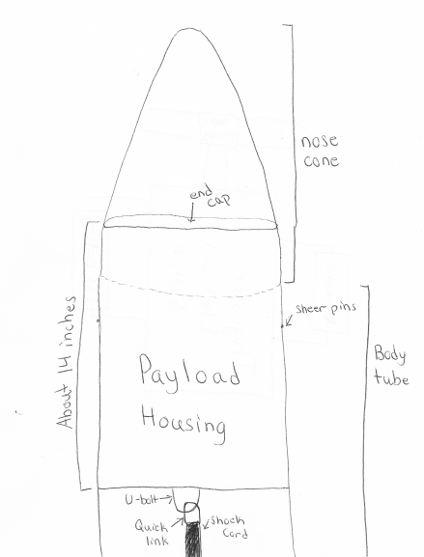
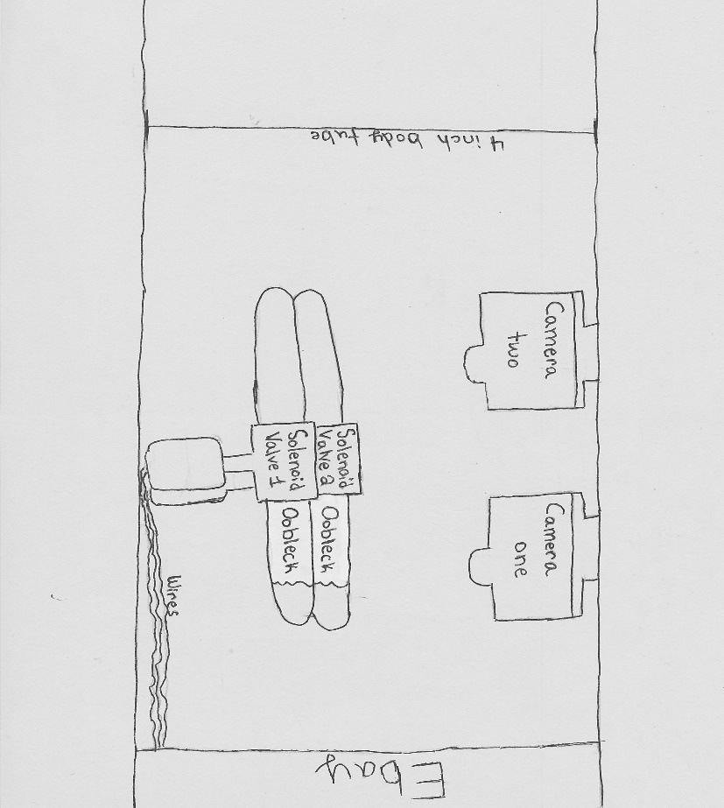
Payload Drawlings
Inside the Payload

Slide 21
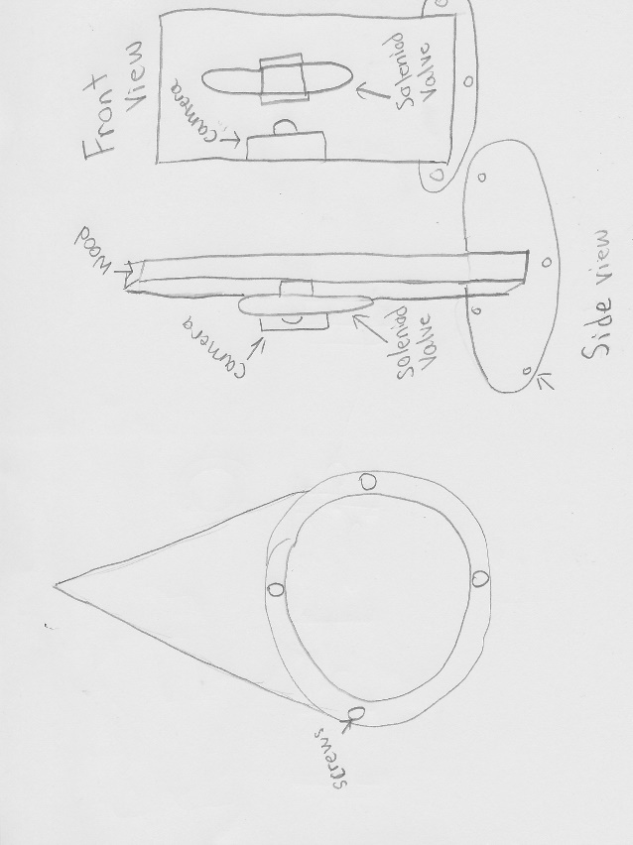

Slide 22
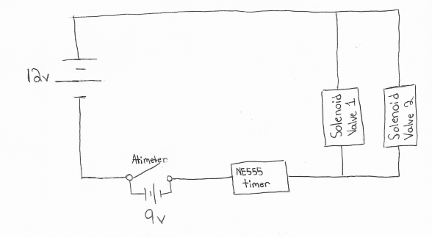
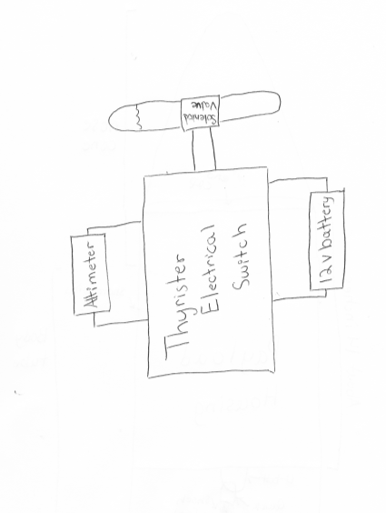
Electronics System
Alternate Electronic system
Electronics System

Slide 23
Challenges and solutions
Challenge | Solution
Keeping the oobleck mixed. | Mix the two parts cornstarch and one part water to make the the colloid within an hour or less before the rocket is taken out to the payload. This will keep the colloid mixture from separating and losing its properties.
The motor selection will determine the length of the of time the rocket accelerates effecting the time of our experiment | We can use RockSims to get an estimation on the time of our rockets acceleration, so we can then set the timer for our experiment.
Determine the optimum dimeter of our test tubes. | If the test tubes are too big and the colloid might solidify under the G-forces, causing the colloid to drop to the bottom test tube. If the test tube is too small then the colloid might stay in a solidified state casing not change during the rockets accent. We can solve this by trial and err or by placing a small ring in the top test tube so when the solenoid valve opens the colloid either turns into a liquid and flows through the hole, or the colloid stays in the top tube do to a solid state of matter.
Getting all electronics to work together at the same time. | In order to insure that all electronics work together at the same time the electronics will be test prior to flight. We also have two of each electronics (solenoid valve and camera) in the nose cone, if in the event that one of the electronics fails to work we have a back up to collect the data.
Creating a rocket that won’t go over 5280 feet. | Design the rocket to fly one mile high or slightly over under perfect conditions. This is accounted for the highly probable that the rocket will weigh 25 percent more than calculated values. Therefore in experimental launches you will have consider all factors like air resistance (that will cause drag) and modify as needed.

Slide 24
Budget Plan
Keep track of the money we spend and receive
Do fundraisers, and add more if need be
Making sure we do not spend more than we are raising
Keeping track of things that were bought

Slide 25
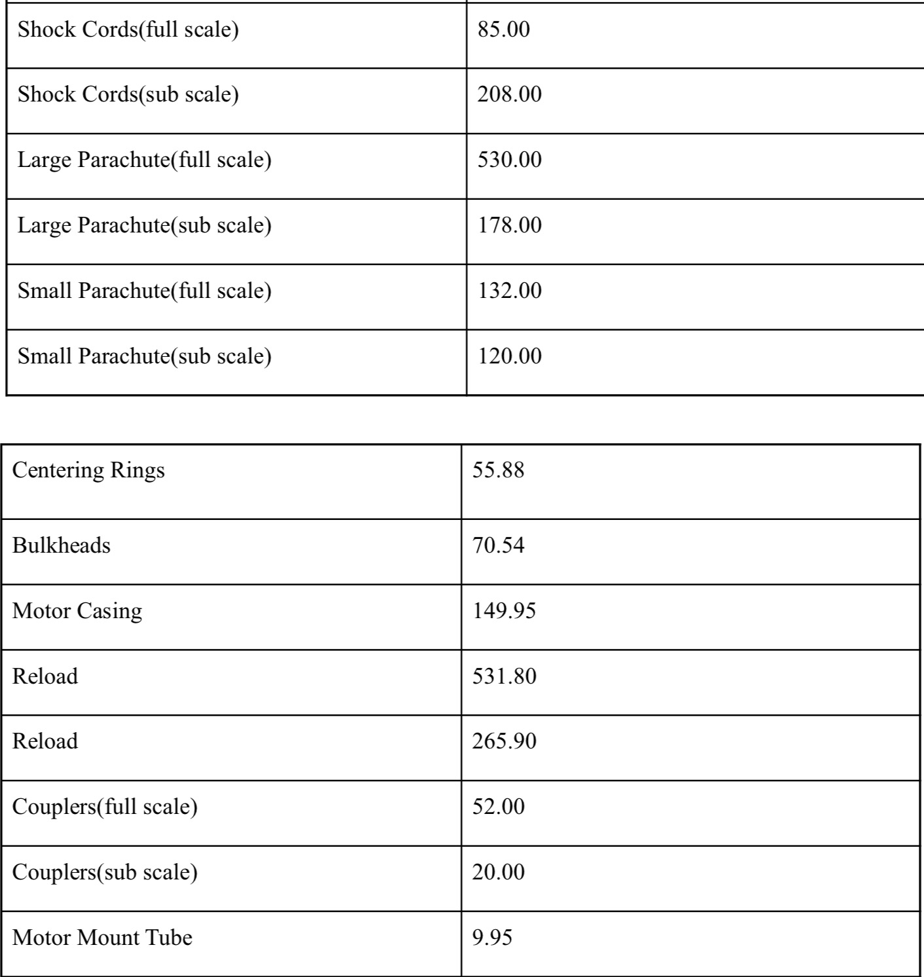
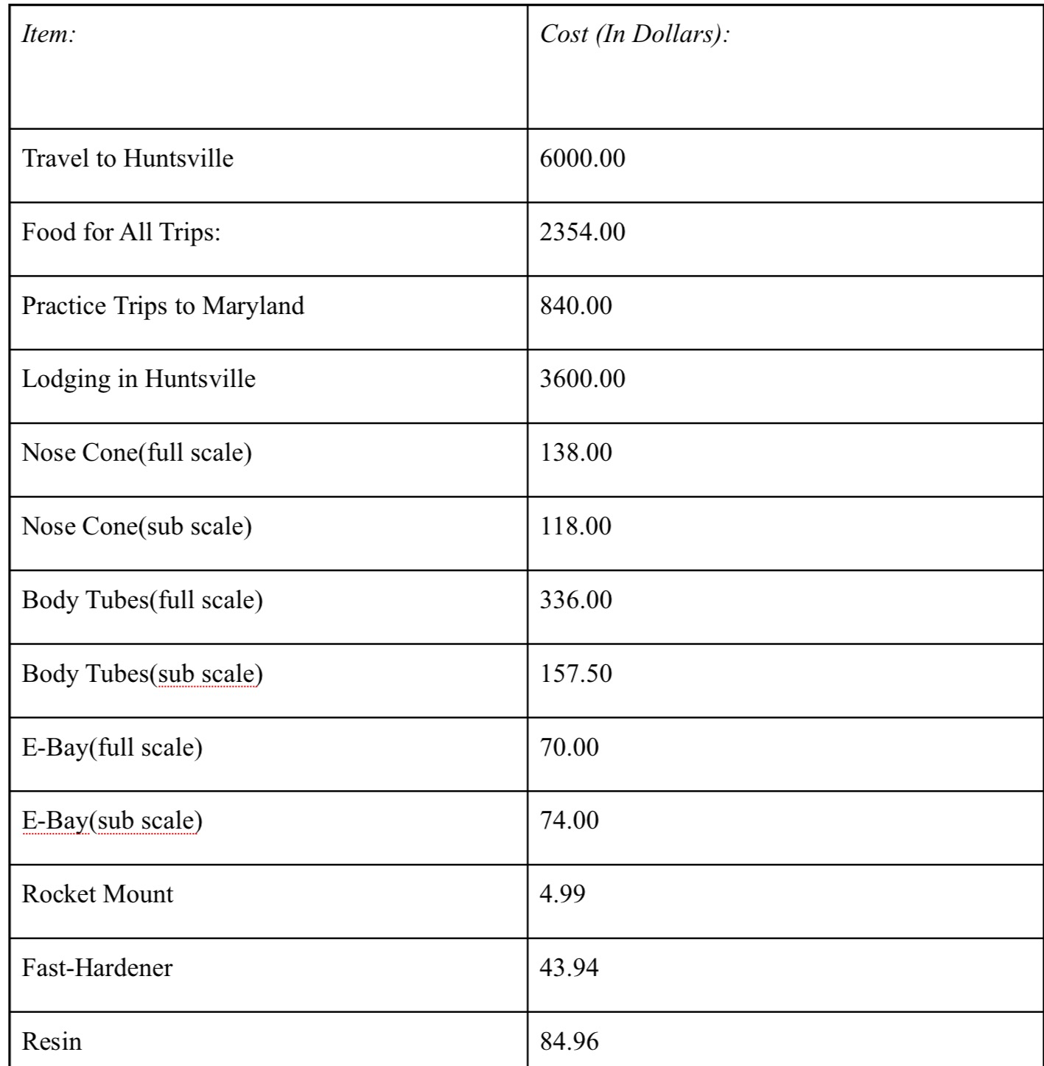
Budget Plan (cont.)

Slide 26
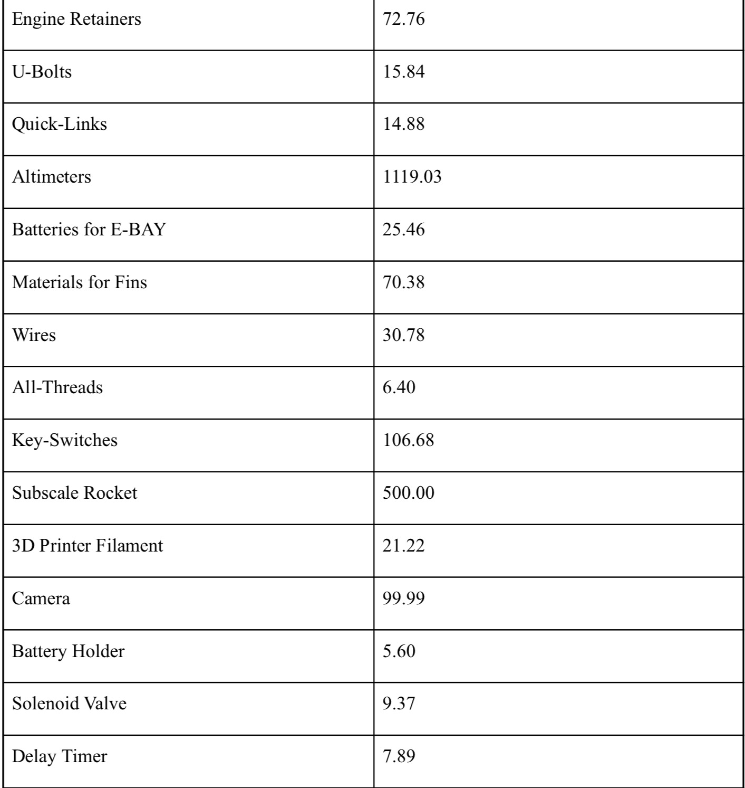
Budget Plan

Slide 27
Funding Plan
This years fundraising include:
Nuts About Granola
Bonus Books
Cotton Candy
Black Squirrel
Paint Night
Rocktopi

Slide 28
Funding Plan (cont.)
Te Connectivity gave us $7,500
Pennsylvania Space Grant Consortium gave us $2,500
National Association of rocketry(NAR) cannon awarded us with $500

Slide 29
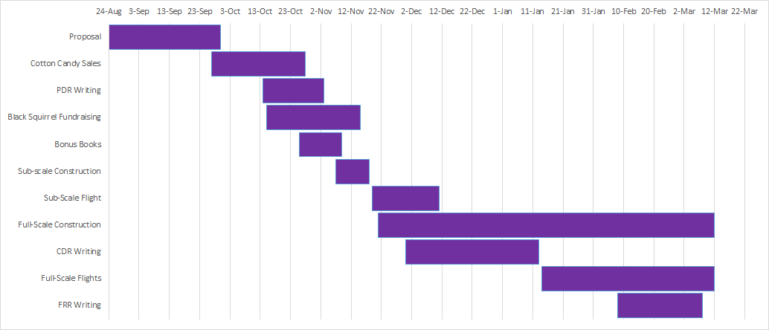
Timeline

Slide 30
Education
Elementary students will receive a more basic understanding of the Tark and SLI programs we have here at Spring Grove Area High Schoo
intermediate and middle school students will receive a more in-depth educational experience of the TARC and SLI programs to get them interested in carrying on into the SLI and TARC programs when they reach the h

