Slide 1
Teaching Engineering Through Rocketry (STEM)
NASA Student Launch Initiative (SLI), Battle of the Rockets (BOTR), The American Rocketry Challenge (TARC), Aerospace Course

Slide 2
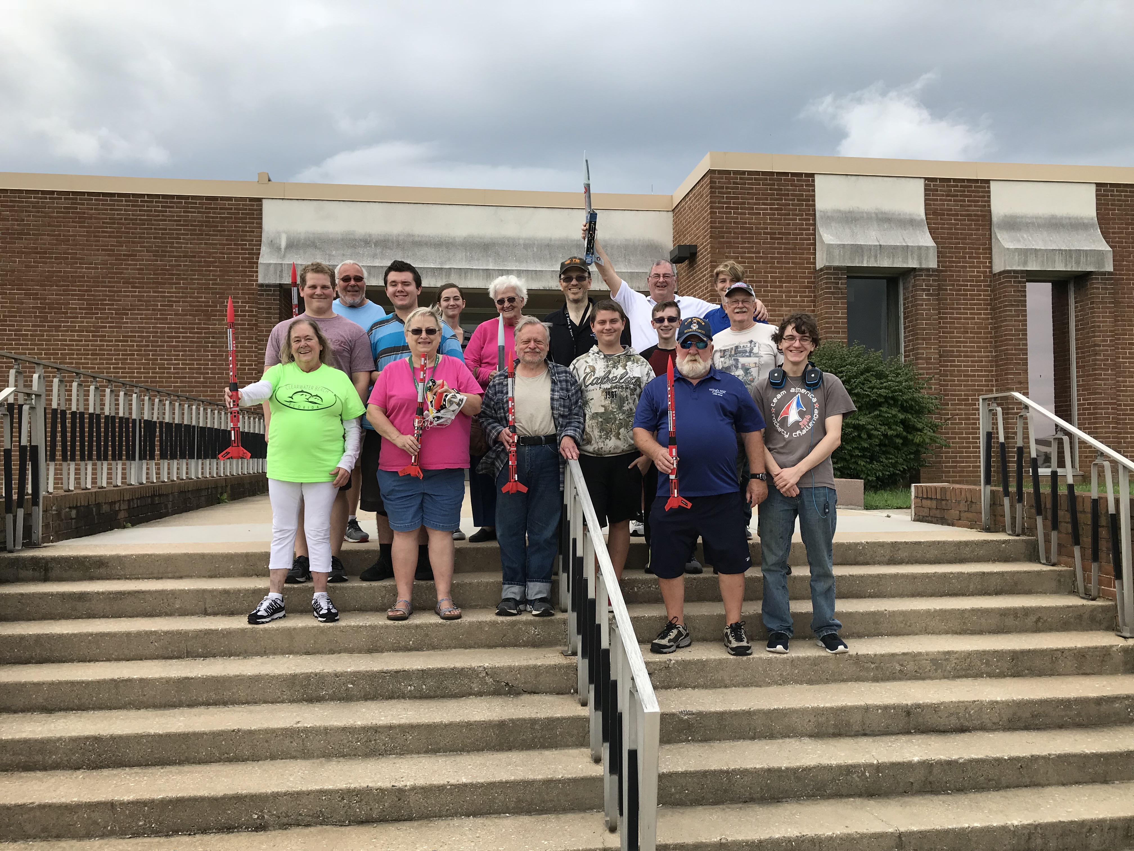
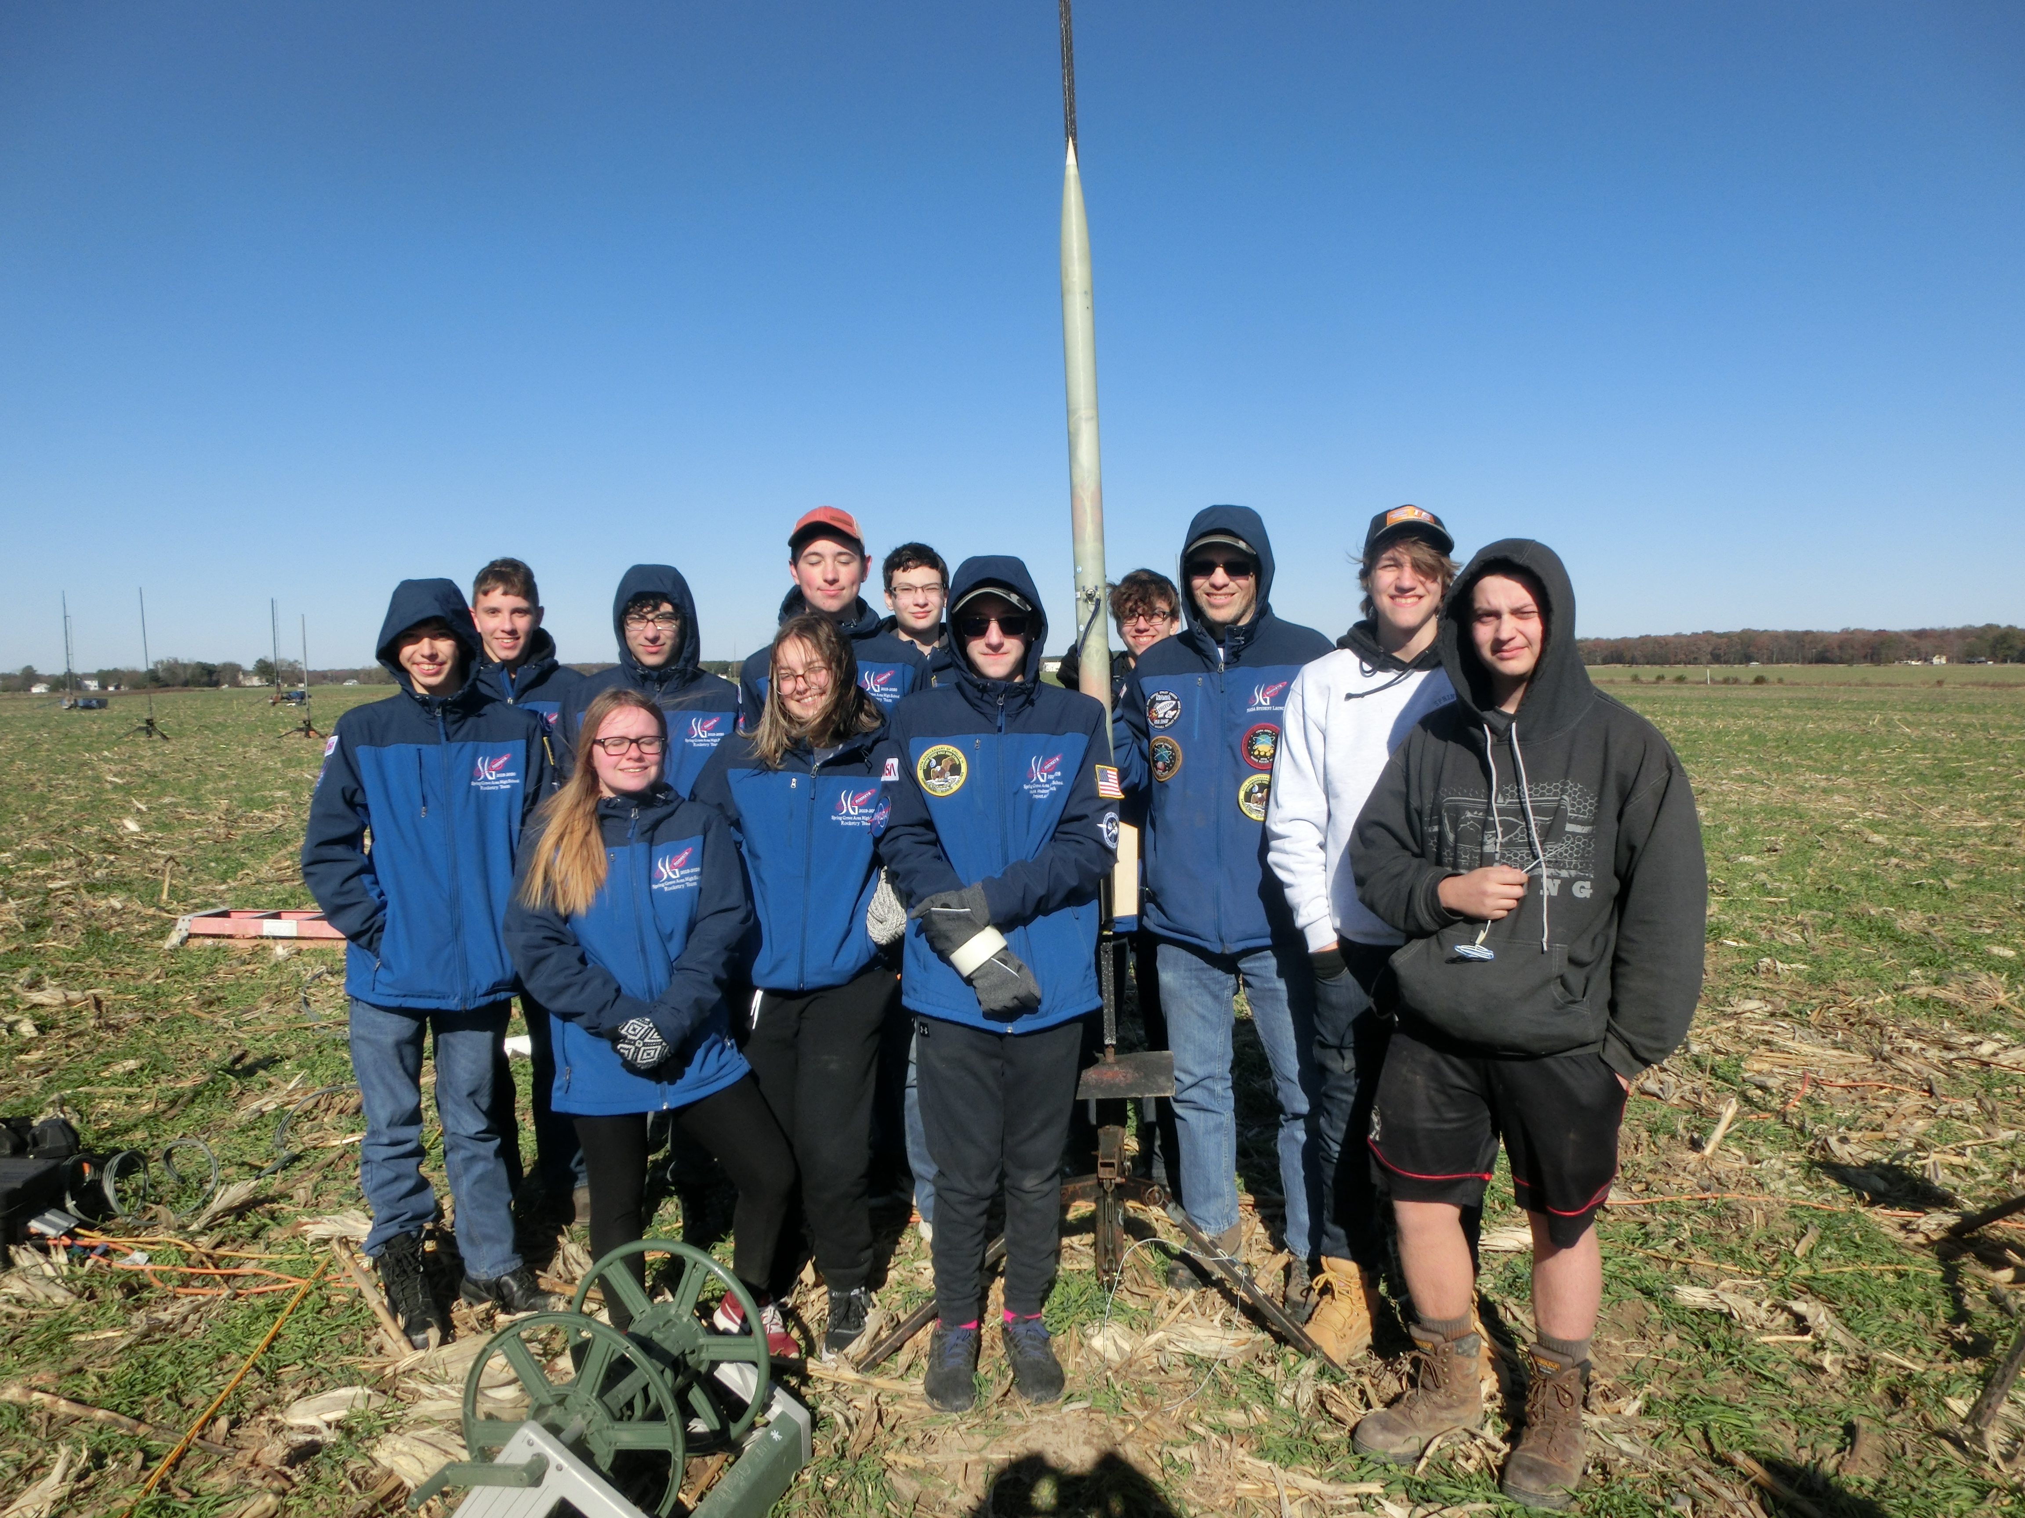
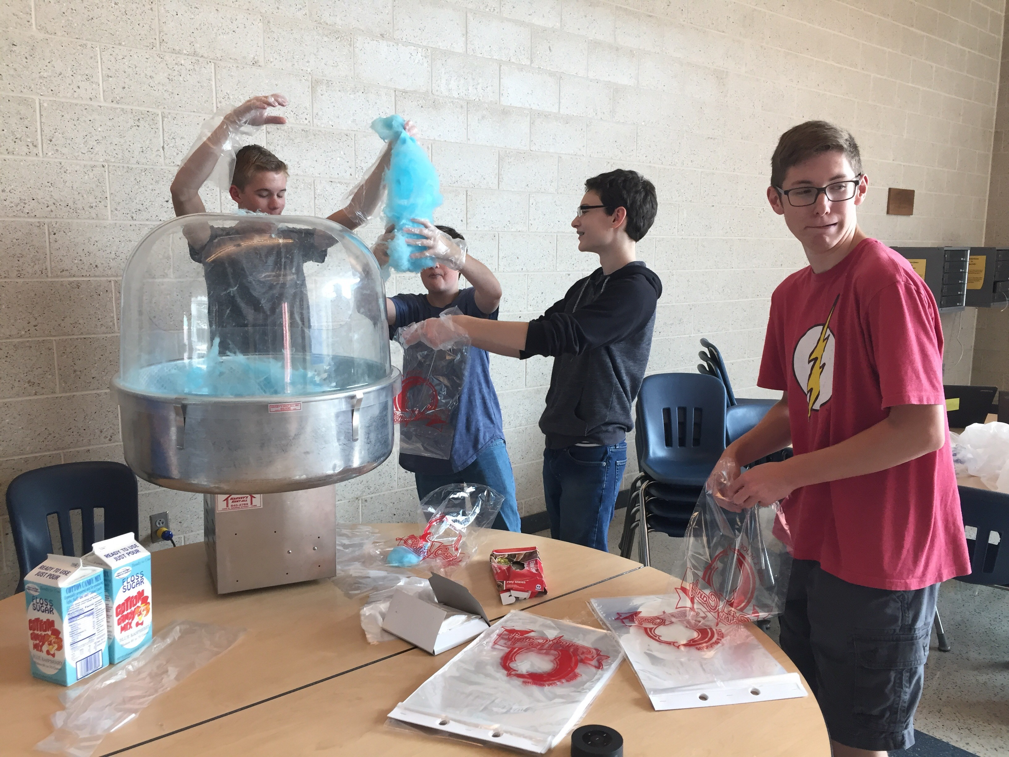
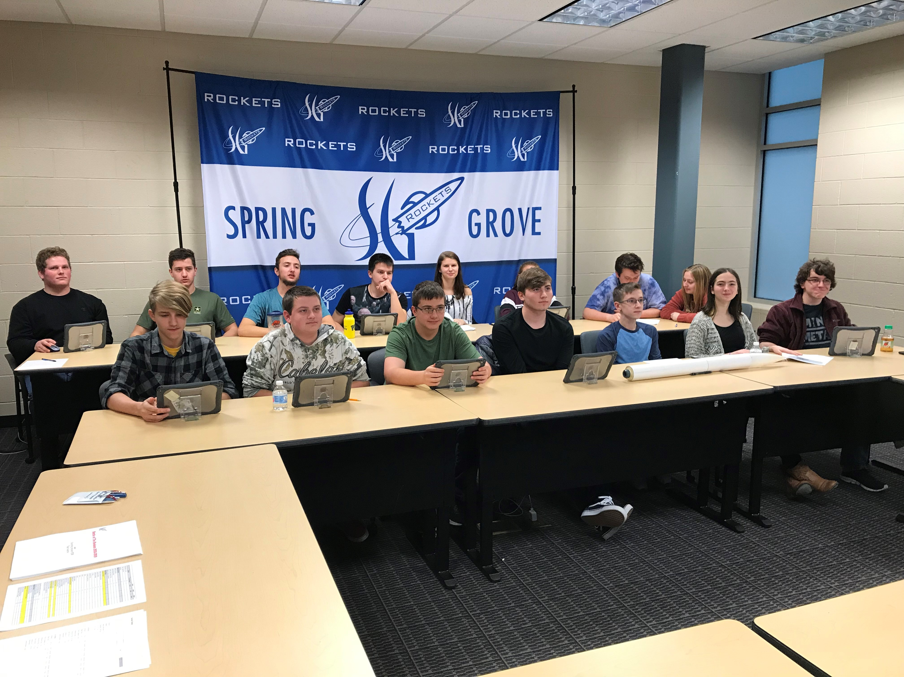
NASA Student Launch
One Rocket, One Mile, One Scientific Payload
Team must be in the top 25 at TARC to submit proposal the following year
Complete full engineering cycle required of contractors suppling NASA
Proposal, Prototype, Design Reviews, Oral Presentations, Fundraising, Educational Engagement, Outreach, Full Scale Testing
Why SLI – teamwork, leadership, intrapersonal skills, interpersonal skills, professionalism, time management, science, engineering, math
Challenges – time, money

Slide 3
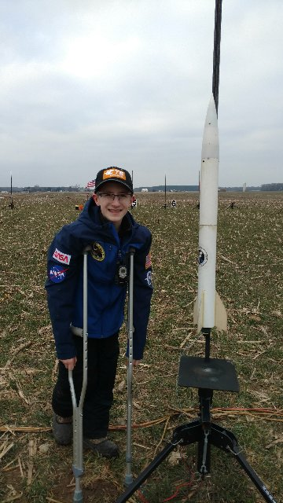
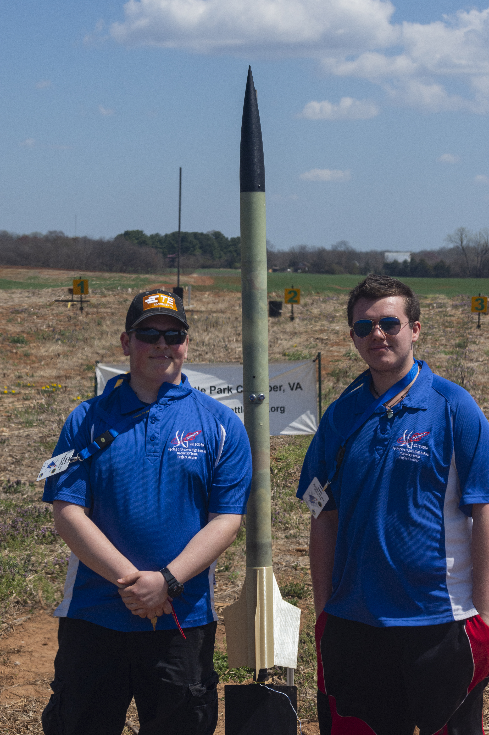
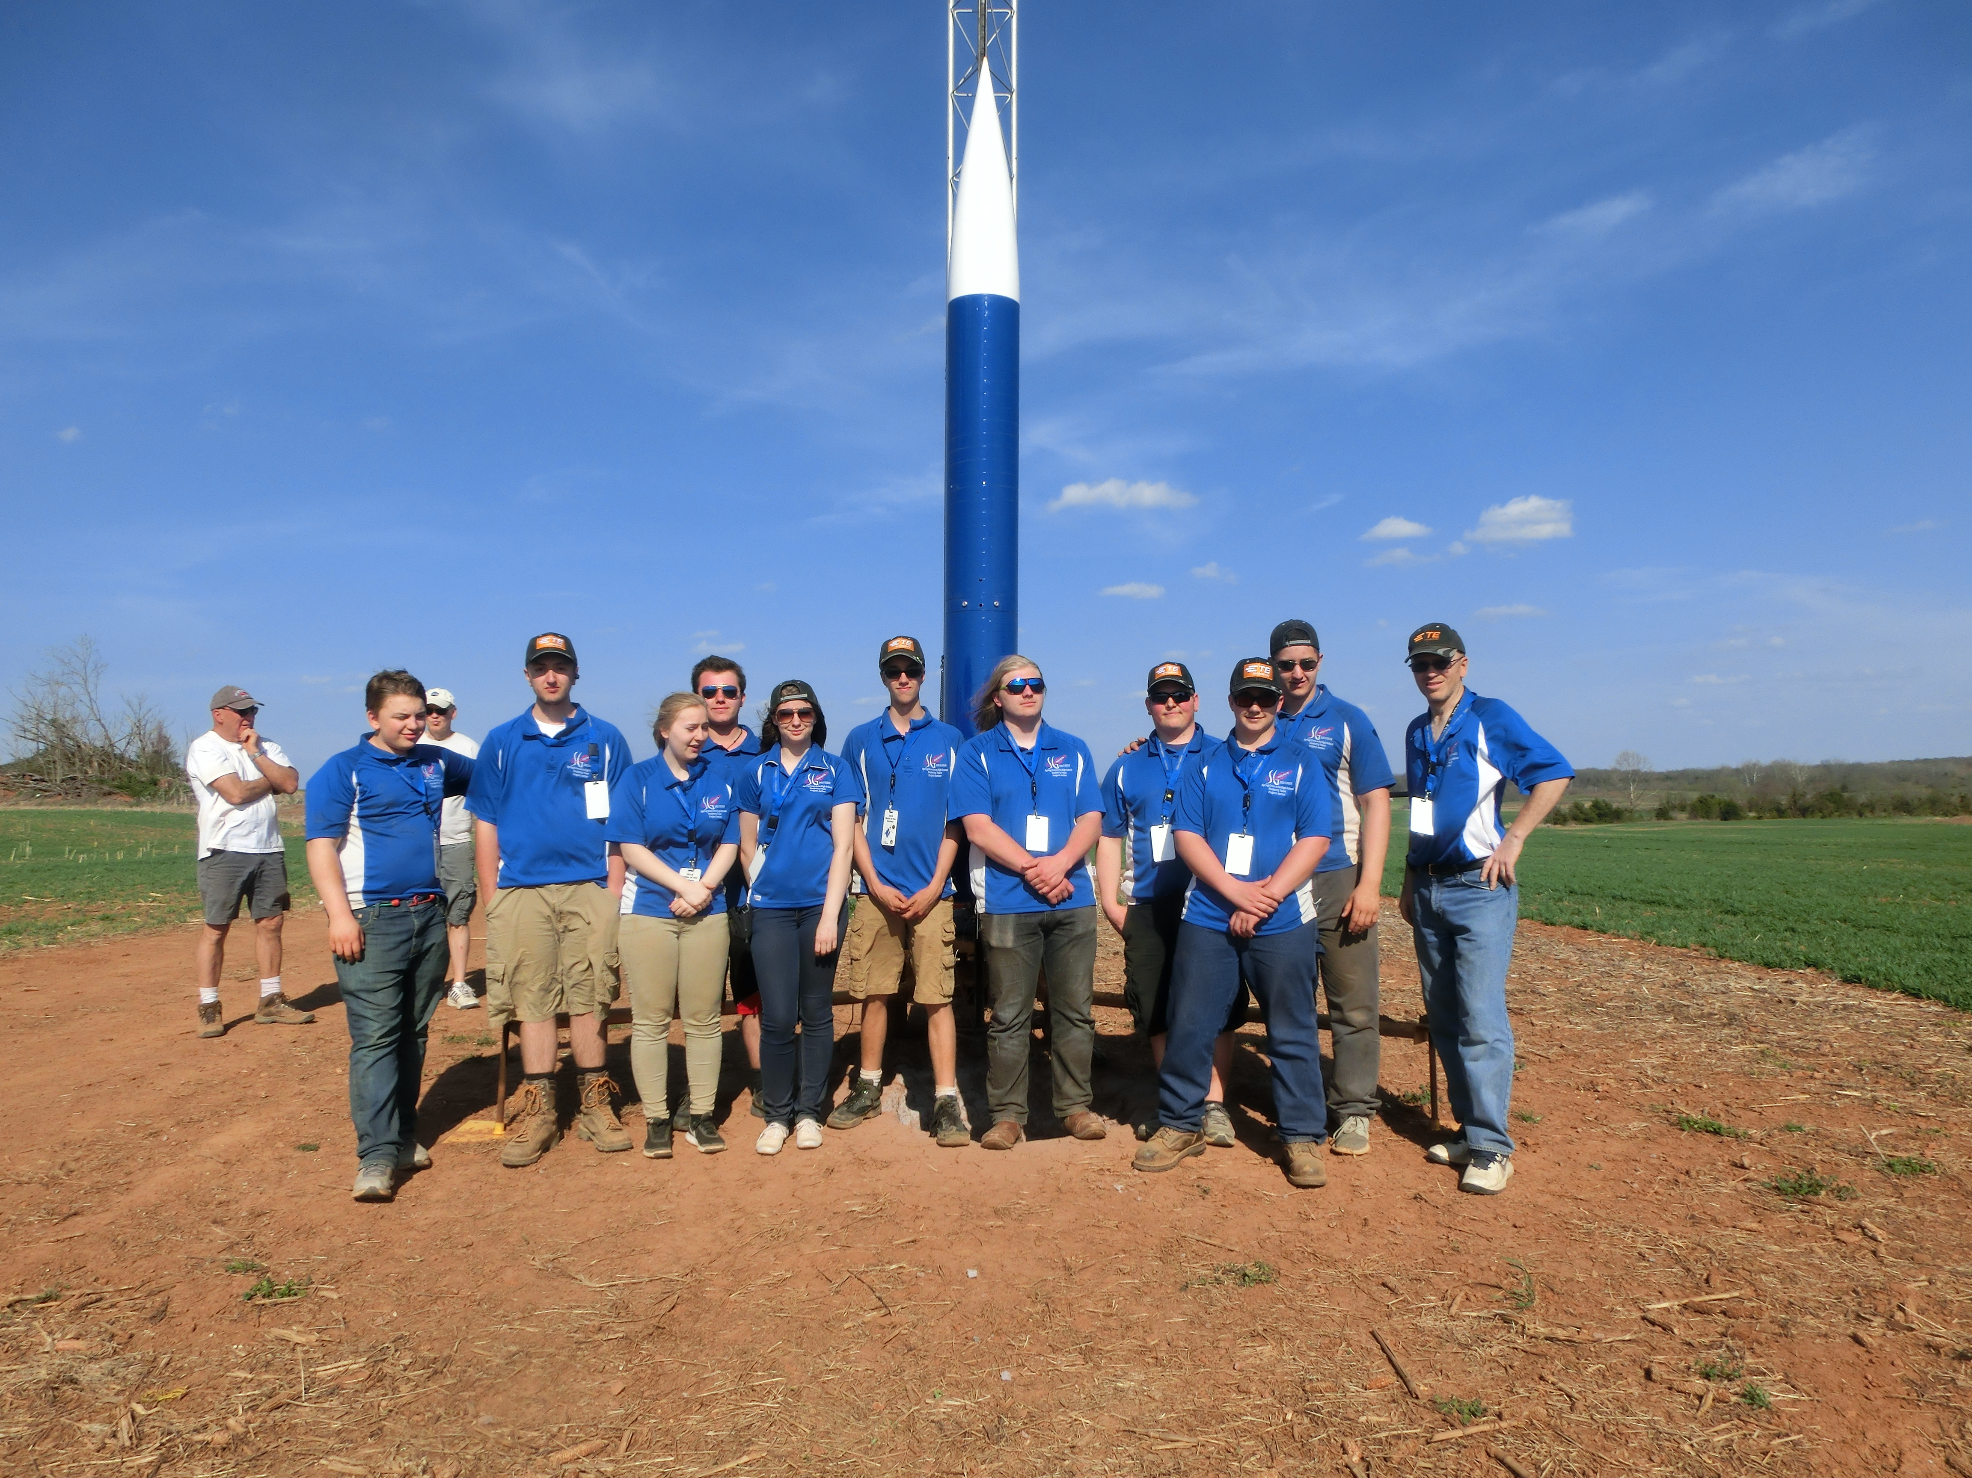
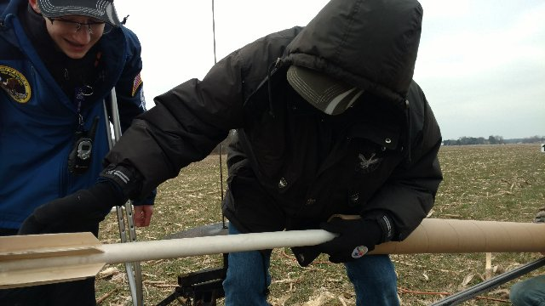
Battle of the Rockets (SLI light) rocketbattle.org
Any team can enter one or all three competitions. This year Deployable Payload, Mars Rover, Target Altitude
Prototype, testing, design reviews, oral presentation, fundraising, final design
Why BOTR- generally smaller rockets, closer competition area, only 2 design reviews and they are Powerpoint/presentation only, more focused and less involved than NASA SLI, target event similar to TARC
Challenges – Finding a testing field, funding, payloads require robotics or electrical experience

Slide 4
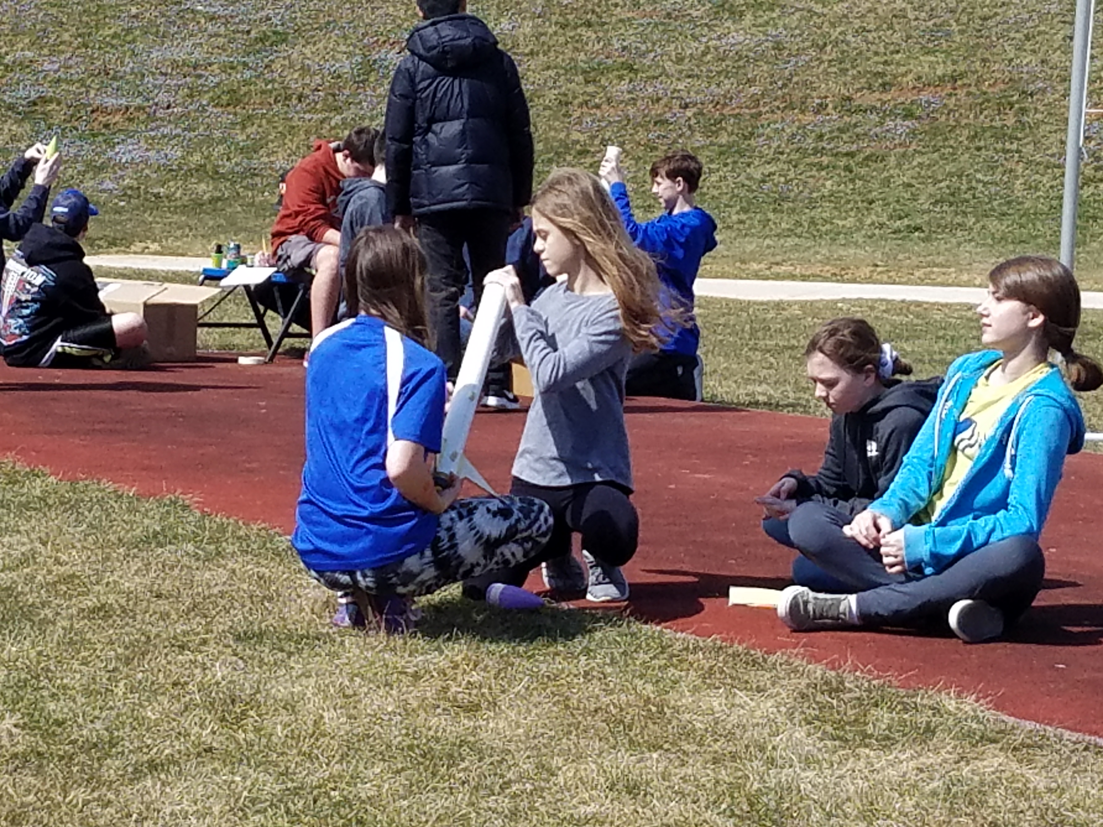
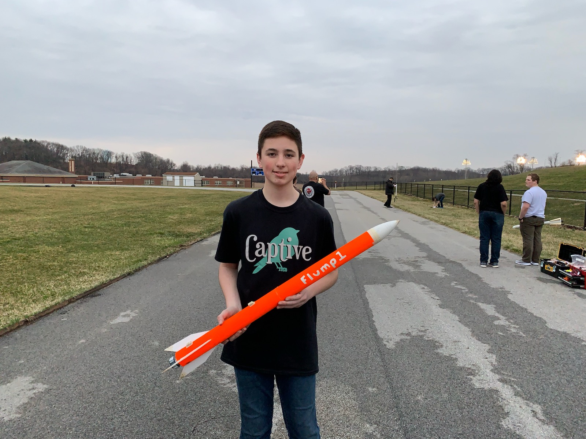
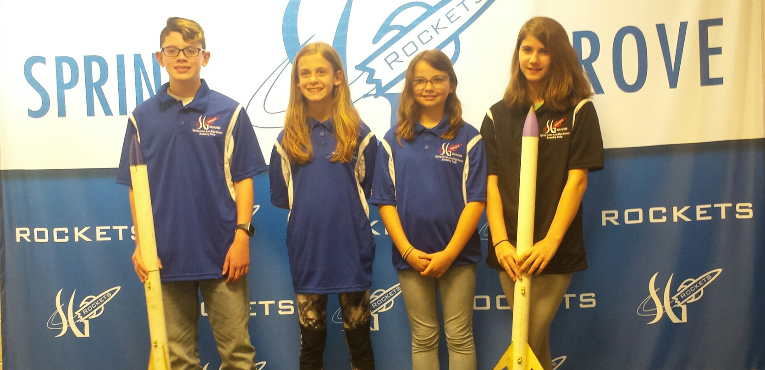
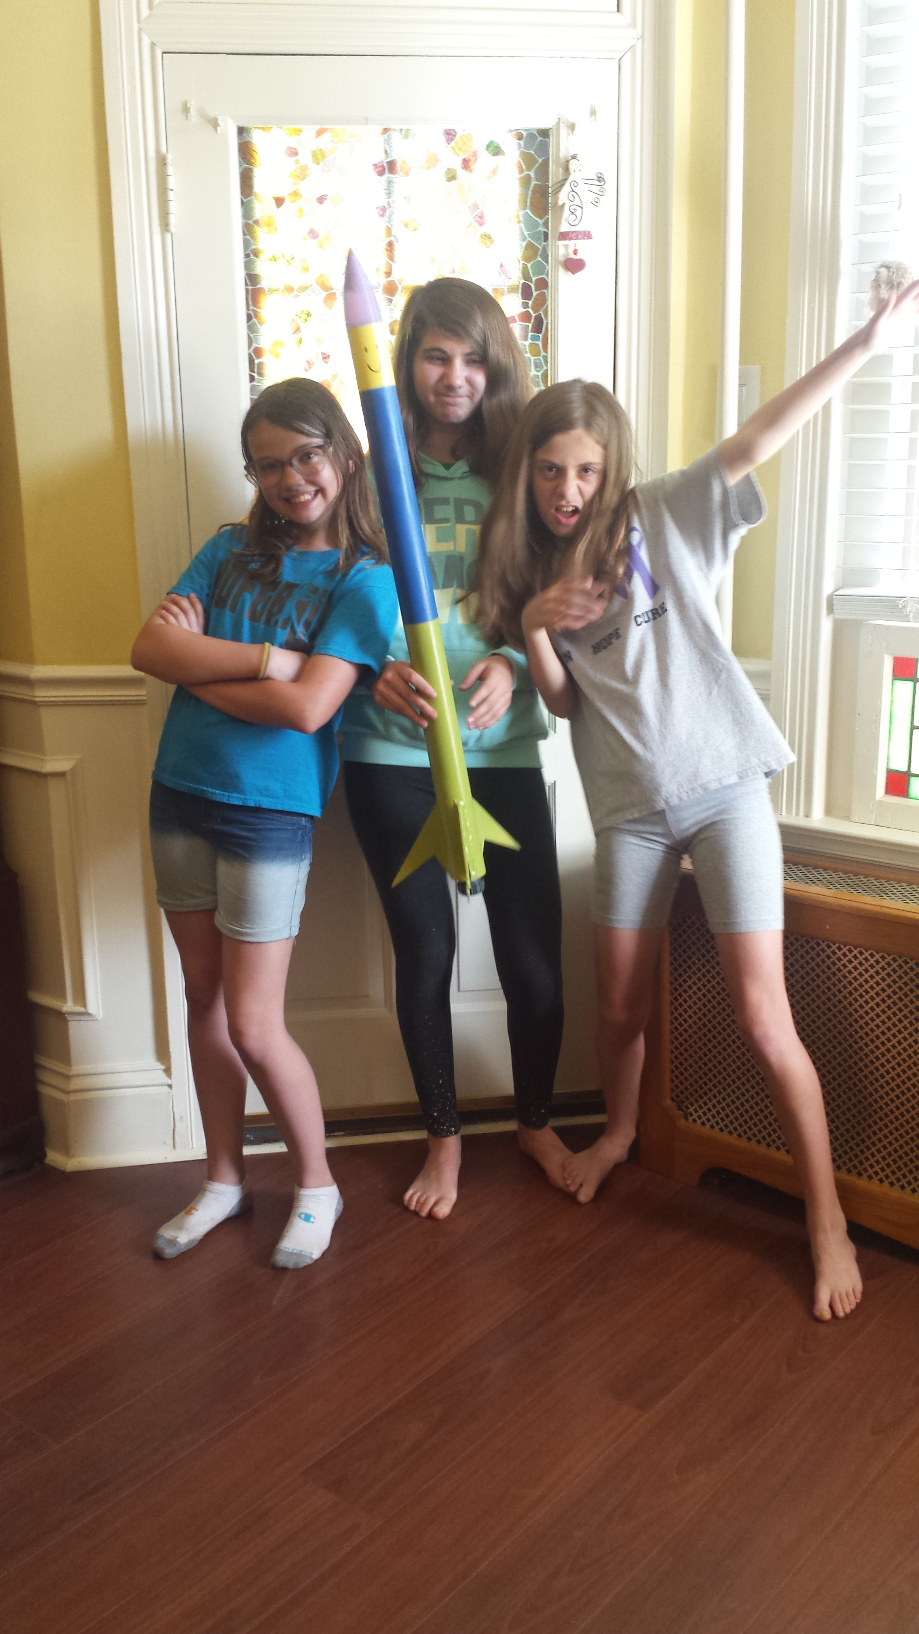
The American Rocketry Challenge (TARC) rocketcontest.org
The world’s largest model rocketry competition for students in grades 6-12
Over 800 teams of 3-10 students entered annually
One egg, 800 ft, 41-43s total flight time
Top 100 teams invited to Nationals in Manasas, VA where top 10 split $100,000 in prize money
Why TARC - Rockets and motors are small, can normally be launched in football/soccer practice field areas, prize money, NAR mentors in every region to help, Title 1 grants available, reasonable for entry level teams, older team members help younger ones

Slide 5
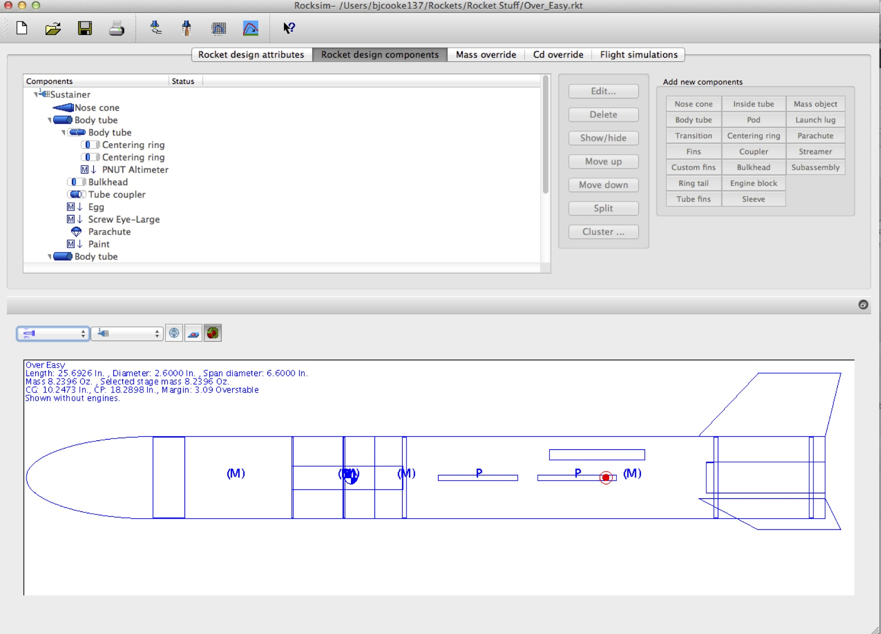
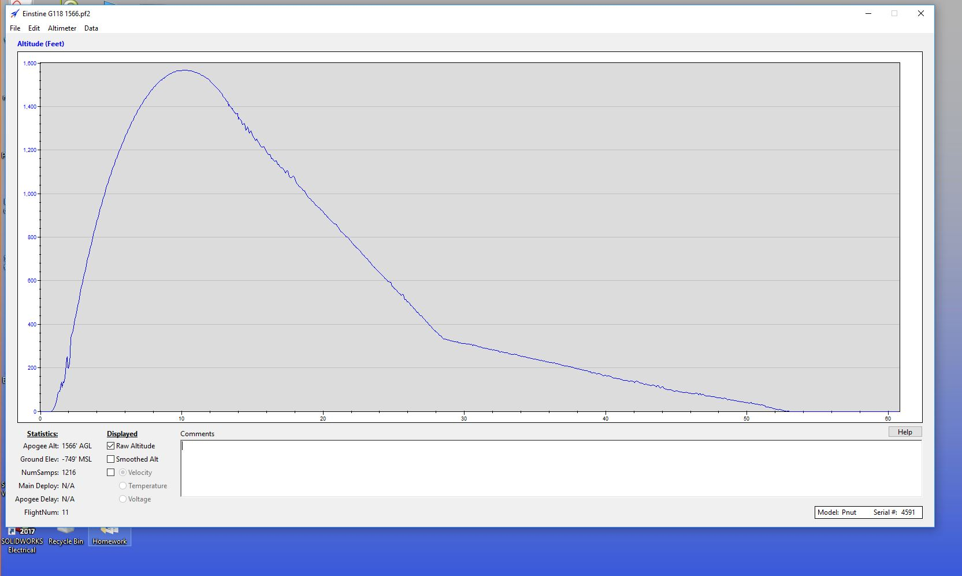
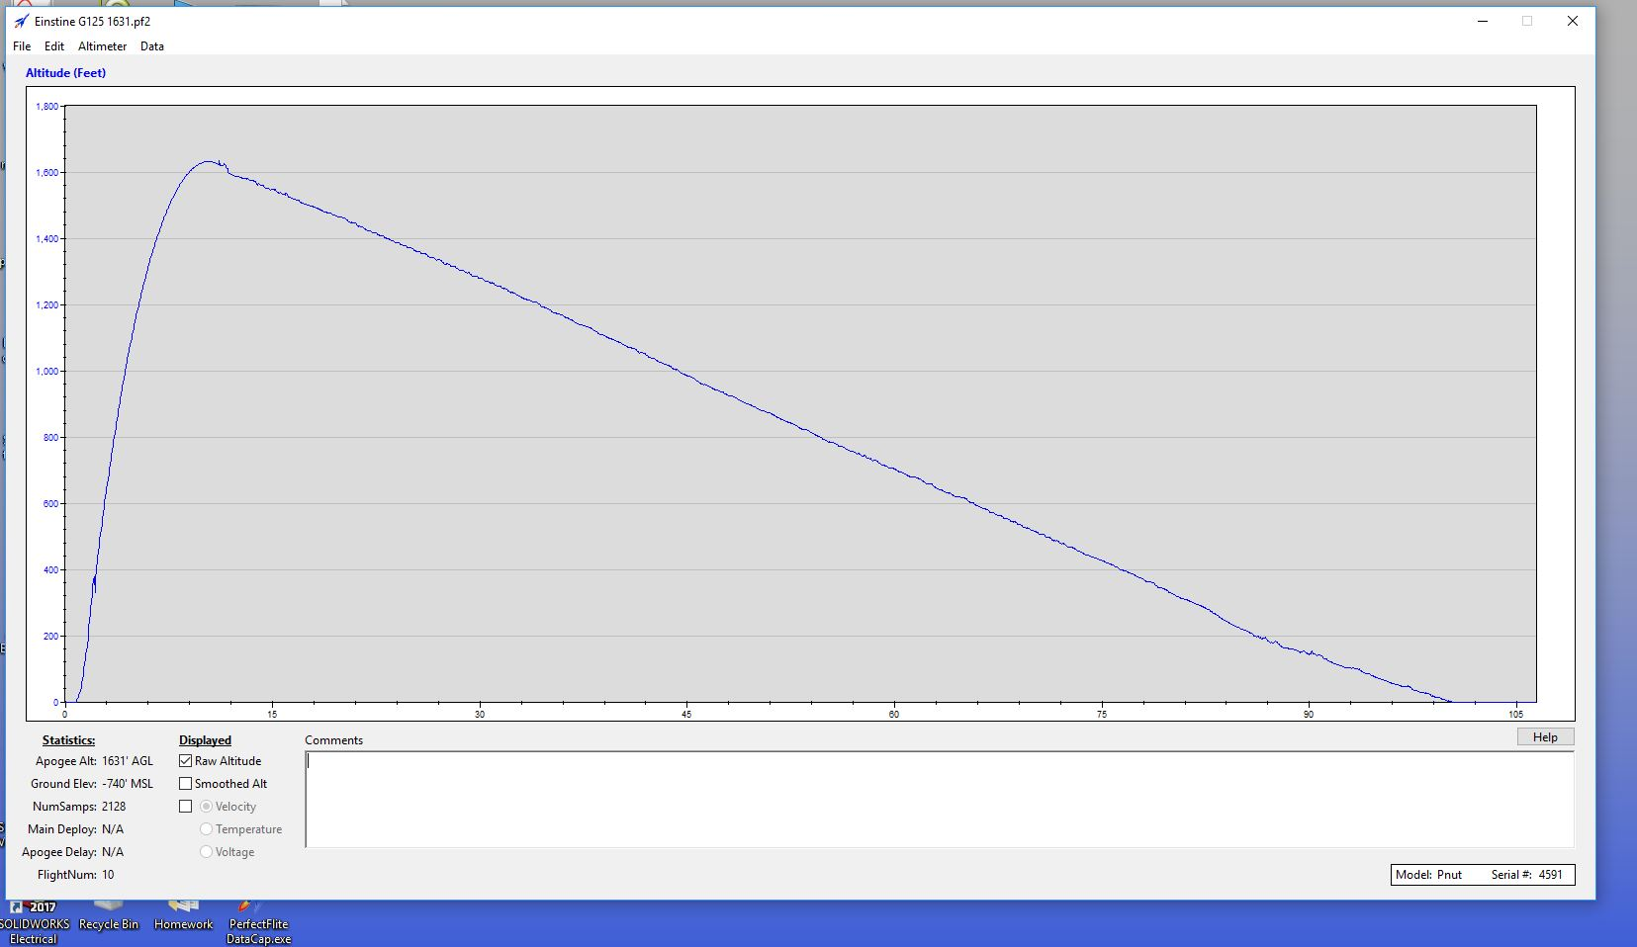
Aerospace Course
Applied physics concepts, rocket design, simulation, construction, testing, analysis, scaling, NAR Safety Code, NAR Certification
Why Aerospace course? – currently there is a large need for pilots and engineers, STEM education push, interest, pathway for the future, excellent on transcripts and applications
Challenges – Time, money for tools and materials, availability of qualified faculty, launch area location

Slide 6
Resources
www.springgroverocketry.weebly.com
@sg_nasa_sl
On Facebook – Spring Grove Area High School Rocket Scientists
hastingb@sgasd.org
www.rocketcontest.org
www.rocketbattle.org
www.apogeerockets.com
https://www.nasa.gov/stem/studentlaunch/home/index.html
Fundraising
PA Space Grant Consortium
TARC Title 1 Grant
Cotton candy – make and sell at football games
Rocket make, launch and take with elementary school students
Corporate sponsorships
Engineering society donations

